Slide 1
CalCode Requirements 113947
Expansion of duties for person in charge
Person in charge must:
Have adequate knowledge of major food allergens, foods identified as major food allergens, and the symptoms that a major food allergen could cause in a sensitive individual who has an allergic reaction.
Educate the employees at the food facility regarding the information described in paragraph (1), which the person in charge may elect to accomplish by, among other methods, using a poster or job aid to which the employee can refer.

Slide 2
Major Food Allergens Defined
Major food allergens include:
Milk
Eggs
FISH, including, but not limited to, bass, flounder, and cod
Crustacean shellfish including, but not limited to, crab, lobster, and shrimp
Tree nuts including, but not limited to, almonds, pecans, and walnuts
Wheat
Peanuts
Soybeans
A FOOD ingredient that contains protein derived from any of the above listed foods e.g. peanut butter
http://www.fda.gov/downloads/Food/ResourcesForYou/Consumers/UCM079428.pdf

Slide 3
Major Food Allergens Defined
Major food allergens do not include:
A highly refined oil derived from a major food allergen, and any ingredient derived from that highly refined oil
An ingredient exempt under the FOOD Allergen Labeling and Consumer Protection Act of 2004 (fresh fruits and vegetables)
http://www.fda.gov/downloads/Food/ResourcesForYou/Consumers/UCM079428.pdf

Slide 4
Symptoms
Symptoms of food allergies typically appear from within a few minutes to two hours after a person has eaten the food to which he or she is allergic.
Hives
Flushed skin or rash
Face, tongue, or lip swelling
Vomiting and/or diarrhea
Abdominal cramps
Tingling or itchy sensation in
the mouth
Coughing or wheezing
Dizziness and/or lightheadedness
Difficulty breathing
Loss of consciousness
Swelling of the throat and vocal cords
Mild symptoms that occur after ingesting a food allergen are not always a measure of mild severity. If not treated promptly, these symptoms can become more serious and can lead to anaphylaxis.
http://www.fda.gov/downloads/Food/ResourcesForYou/Consumers/UCM079428.pdf

Slide 5
Anaphylactic Shock
Following ingestion of a food allergen(s), a person with food allergies can experience a severe, life-threatening allergic reaction called anaphylaxis.
This can lead to:
constricted airways in the lungs
severe lowering of blood pressure and shock (“anaphylactic shock”)
suffocation by swelling of the throat
Each year in the U.S., it is estimated that anaphylaxis to food results in:
30,000 emergency room visits
2,000 hospitalizations
150 deaths
http://www.fda.gov/downloads/Food/ResourcesForYou/Consumers/UCM079428.pdf

Slide 6
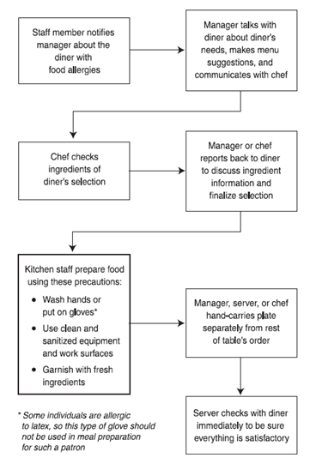
How a Food Allergy Order May Travel Through the Restaurant
http://www.foodallergy.org/document.doc?id=143

Slide 7
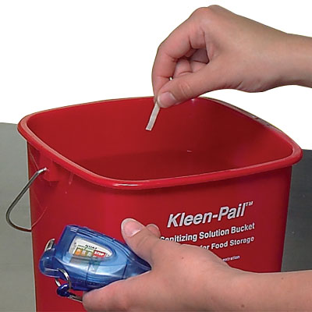
Cross-Contact
How it Occurs
Putting food on surfaces that have touched allergens
Not washing, rinsing and sanitizing utensils
How to Avoid it
Wash, rinse, and sanitize cookware, utensils, and equipment after handling a food allergen.
Wash your hands and change gloves before prepping food.
Prep food for customers with food allergies in a separate area from other food.
Label food packaged on-site for retail sale. Name all major allergens on the label and follow any additional labeling requirements.
Designate different shelves for allergen free foods.
Select manufacturer pre-packaged foods with labels instead of foods from bulk containers.
http://www.foodsafetymonth.com/NFSM/media/activities/English/Weekly_Activities_Eng/NFSEM_wk5_Actvy.pdf?ext=.pdf

Slide 8
Questions

