Slide 1
Present

Slide 2
Community Supported Agriculture
February 18, 2014
Environmental Management Department
Tara Stout
Food Safety and Certifications Manager

Slide 3
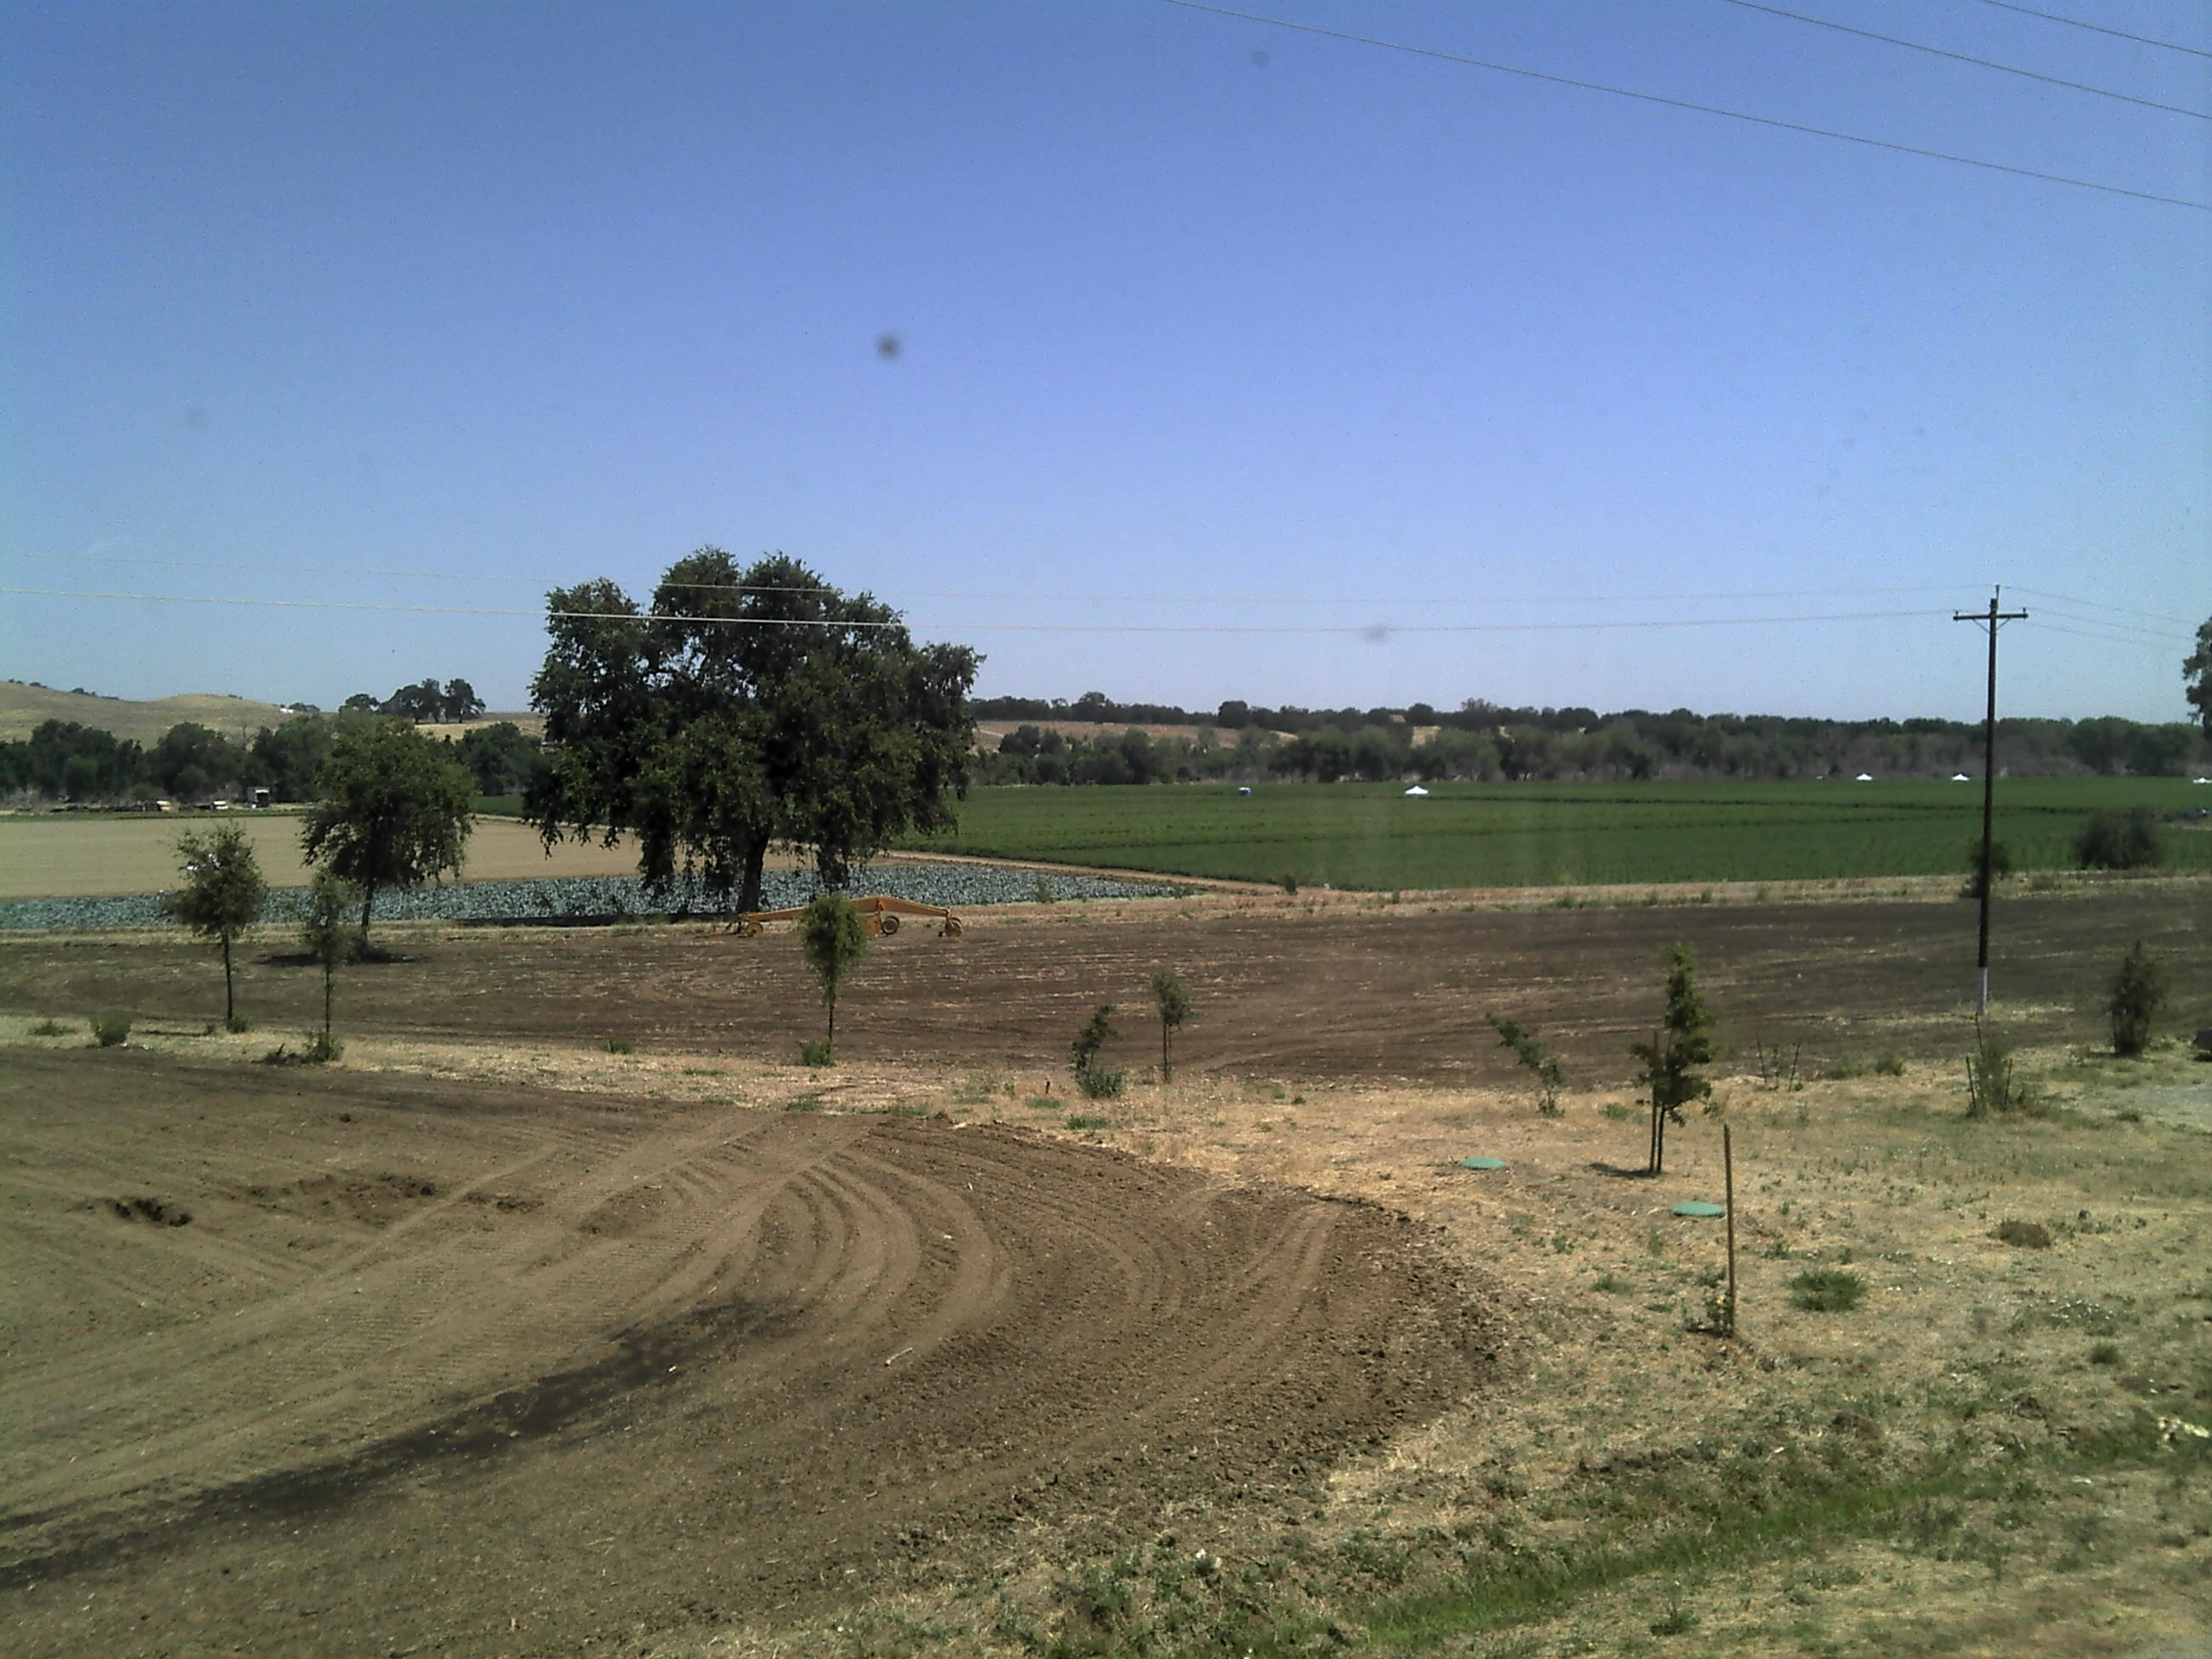
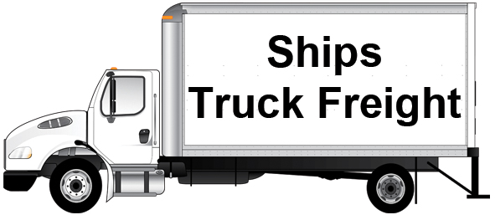
A brief overview of How Capay inc. Operates:
Suppliers
Grocery Stores
Restaurants &
Farmers Markets
Capay Inc. Farms
Dist. & Logistics
CSA: Community Supported Agriculture
Other Farms
Notes:
Difference between CO and FFTY

Slide 4
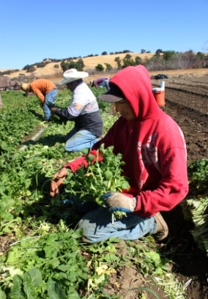
It all begins at the farm
Harvesting
Weather permitting – begins at 6am
Packing
Harvest dependent – begins at 9am
Commodity Specific
Field packed - lot codes
RPC (Re-usable Plastic Container)
Harvest bin
Notes:
Frost, etc. postpone harvest times or rain
Field packed (boxes) get lot codes and after packed into boxes or clamshells – lot codes

Slide 5
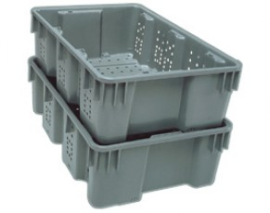
Harvest bins & rpc’s
Notes:
Melons or winter squash in bins
RPCs – smaller commodities like grapes

Slide 6
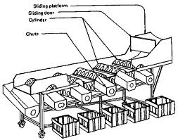
Sizing line
Notes:
Smaller falls through first and holes in conveyor get bigger as move down the line so largest product at end.

Slide 7
Washing line
Notes:
Similar to car wash – place carrots or root vegetables on conveyor and spray from above. Water falls into bins below and filtered through filters in storage area to right and re-circulated. Tested and refreshed.

Slide 8
Hydrovac
Notes:
Hydrovac is our blast chiller – vacuums air out to chill quickly for quality – can use water to cool product also like a car wash. Staged to be shipped to west sac.

Slide 9
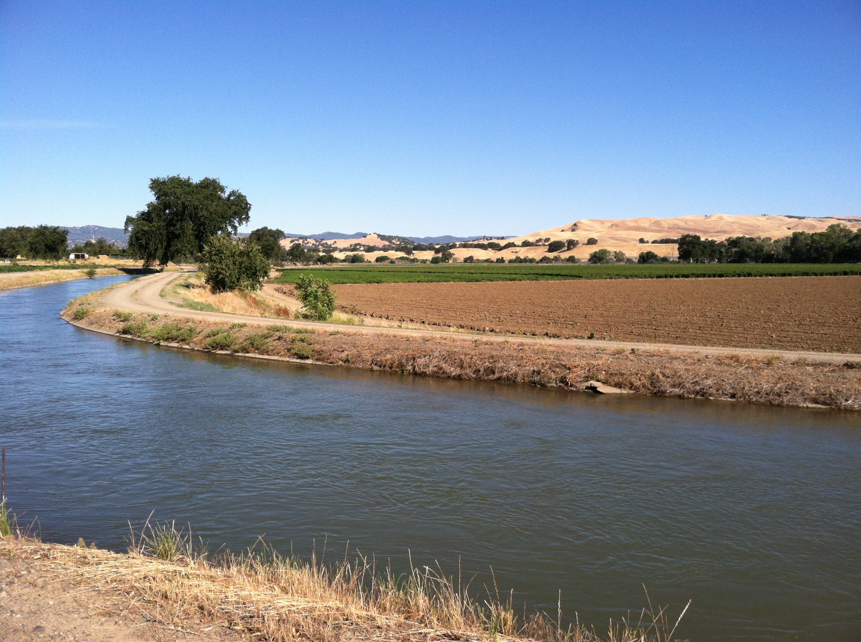
suppliers
Supplier Requirements:
Organic Certification (if applicable)
Food Safety Certificate
Indemnification Agreement
Reason for additional suppliers:
Variety of product/Specific Commodity
Build relationships with small farms
Product is trucked to the West Sac Distribution center daily
Will be used by FFTY or CO wholesale
Additional Suppliers deliver their product to West Sac

Slide 10
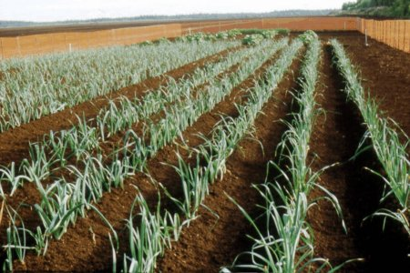
Our Food Safety & certifications
Distribution Centers
Certified by Ceres - GMPs
Farms Certified
by Primus - GAPs
All farms & facilities: CCOF certified - Organic
Notes:
We discussed what suppliers need to supply to us….this is our cert status if we want to supply to someone like a grocery store. CCOF has requirements for labeling similar to new bill.

Slide 11
West Sacramento distribution center
Product is received and stored in 1 of 3 different coolers – commodity and temperature specific
FFTY Orders are finalized two days prior to delivery date for inventory and delivery routes
Prep Crew:
Sunday – Wednesday 6pm-5am
Weigh or portion out product

Slide 12
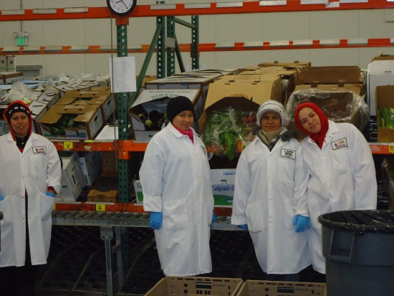
West Sacramento distribution center
Packing Crew:
Monday – Thursday 6am-5pm
Assemble boxes as selected by customers preferences
Exclusions and substitutions
Origin of product
Each box receives
Farm News
Recipes
Contents of box list
Regulars assembled in AM
Specials assembled in PM
Pallets of boxes are organized reverse of delivery order
Notes:
Pick to light and how it works to pack boxes – 4,500 boxes per day 18k per week.

Slide 13
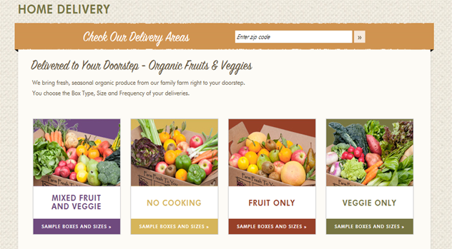
Community Supported Agriculture | February 18, 2014
Notes:
Box types to choose from

Slide 14
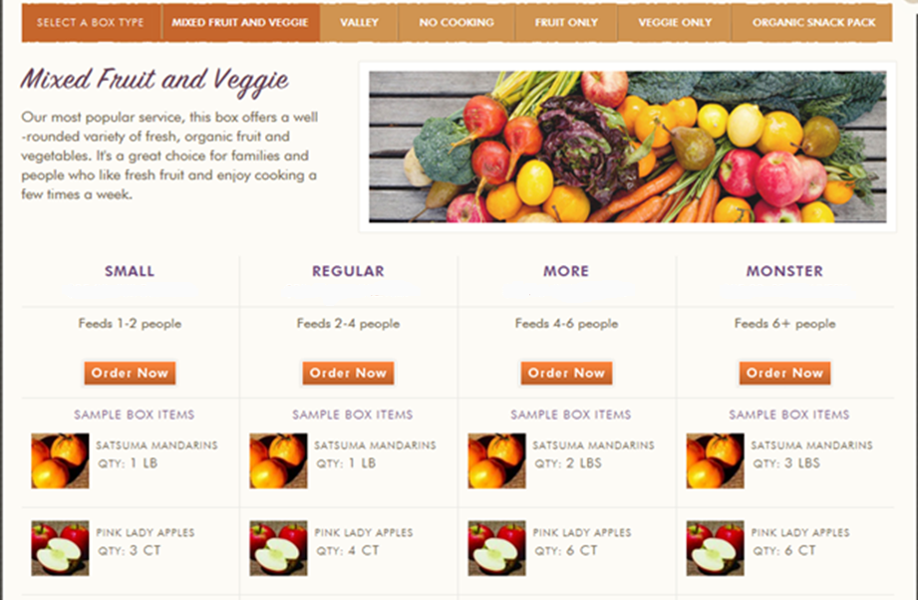
Notes:
Each box comes in additional sizes and indicates where product originates from

Slide 15
Delivery date assigned by zip code
Delivery order uploaded to GPS for drivers
Vans stagger loading boxes beginning at 7PM
Delivery of CSA boxes can occur between 8PM and 10AM – Dependent on location business vs. residence
Delivery

Slide 16
Pictures posted by customers:

Slide 17
Pictures posted by customers:

Slide 18
Company history
Video Clip:
http://www.americasheartland.org/episodes/episode_913/organic_farm.htm#

Slide 19
The Company’s Vision:
People participate in a transparent food system where communities and sustainable farms are connected.

Slide 20
Questions? & Thank you!

