Slide 1
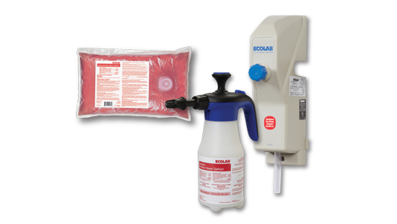
SaniSAVE
Philip Bryant
Jill Ann Williams

Slide 2
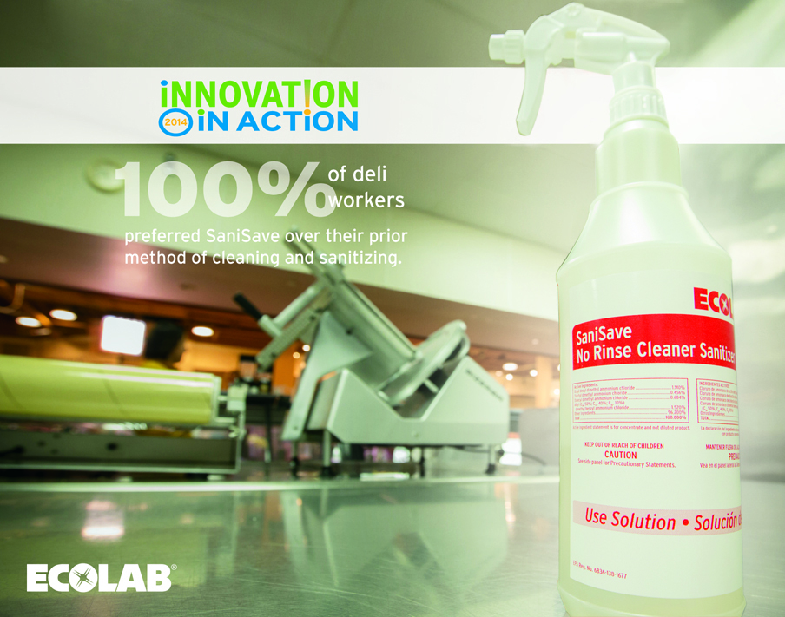

Slide 3
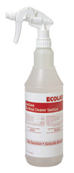
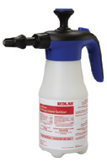
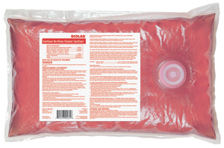
SaniSAVE Program
EPA REGISTERED TO REDUCE 99.999% OF LISTERIA MONOCYTOGENES
Simplified process reduces food safety risk
  3 solutions in 1 for food and non-food contact surfaces throughout the store
  (deli slicers, service cases, scales, countertops, stationary equipment, hard/nonporous surfaces)
    Cleaner
    Water
    Sanitizer
Proven to clean better than wash-rinse-sanitize
  Increased microbiological cleaning by 83%
  (see slide 3)
Simplified process takes less time to complete
  More than pays for itself in reduced employee labor
  (see video and slide 4)
1
2
3

Slide 4
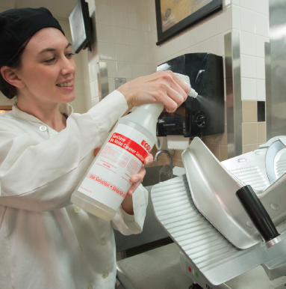
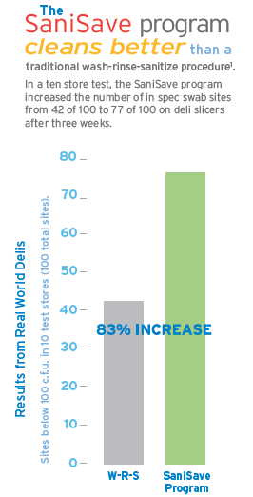

Slide 5

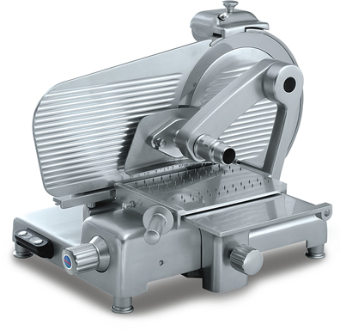


SaniSave Program Requires Less Labor
20 min
13 min
7 min/slicer SAVED*
X 6 cleanings/day
255
LESS LABOR HOURS REQUIRED per year per store
*based on actual store associate cleaning times in a ten store test

Slide 6
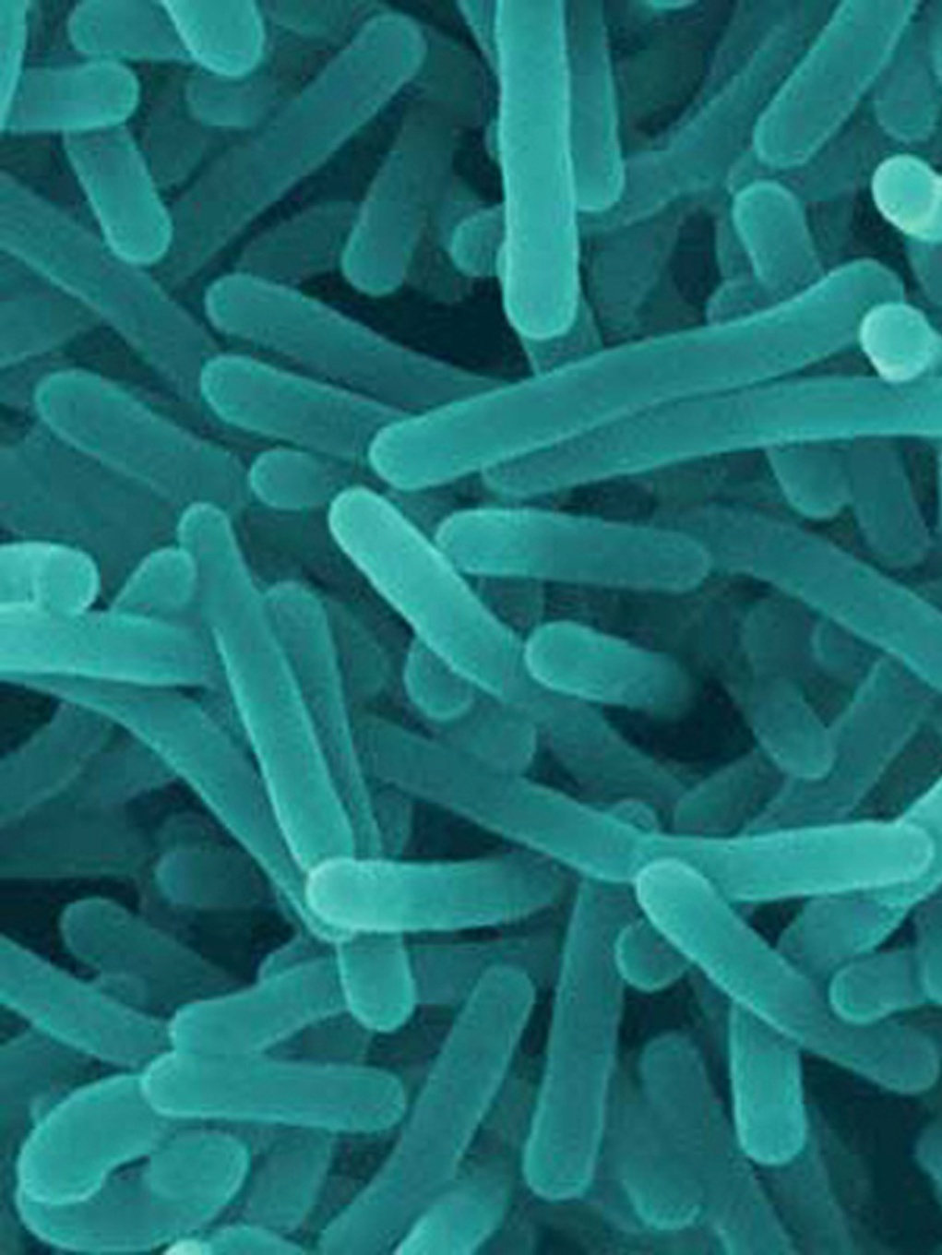
TRADITIONAL WRS SOP
HIGH COMPLEXITY = LOW COMPLIANCE = FOOD SAFETY RISK
Foodborne Pathogen Death Rates
Campylobacter spp.
Norovirus
Listeria monocytogenes
Toxoplasma gondii
Salmonella, nontyphoidal
60%
Retail Delis Tested Positive for Listeria Monocytogenes
Source: Sauders, Brian D., Maria D Sanchez, Daniel H Rice, Joe Corby, Stephen Stich, Esteer D Fortes, Sherry E Roof, and Martin Wiedmann, “Prevalence and Molecular Diversity of Listeria monocytogenes in Retail Establishments,” Journal of Food Protection, Vol. 72, No. 11, 2009, Pages 2337–2349
Notes:
We now connect the high level data to Food Retail. Having established that Lm is extremely dangerous, you can now talk to the fact that numerous studies have documented how the challenge that Food Retailers have with regard to Lm… particularly in delis.

Slide 7
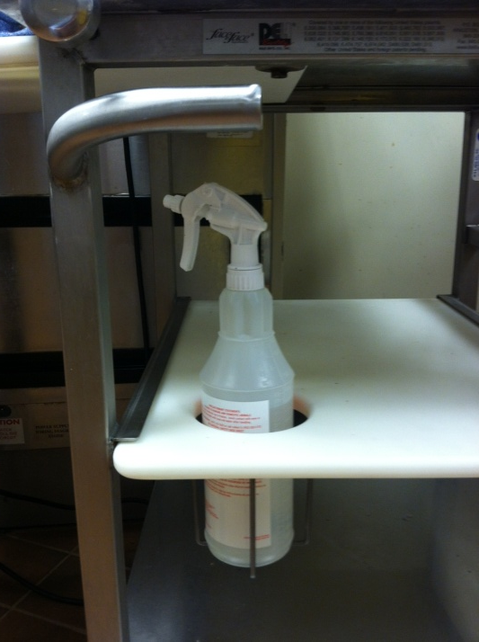
Food Contact Surface Cleaning/Sanitizing
Customer Problem
Vision
Solution
WRS SOP
HIGH COMPLEXITY = LOWER COMPLIANCE
1 PRODUCT SOP
LOW COMPLEXITY =
HIGHER COMPLIANCE

Slide 8
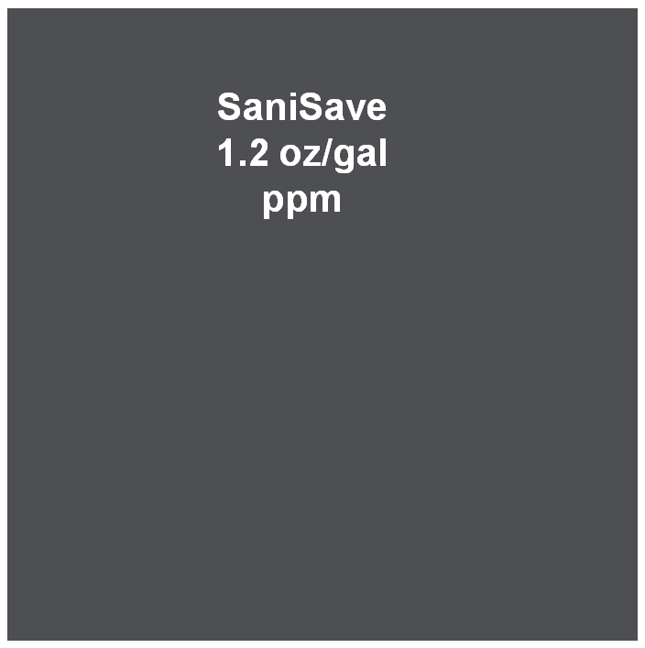
SaniSave No Rinse Cleaner Sanitizer
Chemistry
Cleaning ingredients + quaternary ammonium active
Replaces PnP & KQII with one product for hard surface cleaning & sanitizing
One concentration for both cleaning & sanitizing
Ingredients are appropriately cleared by both FDA and EPA for use on food contact surfaces.
Meets the Food Code Section 4-501.115, Manual Warewashing Equipment, Chemical Sanitization Using Detergent-Sanitizers:
    “If a detergent-sanitizer is used to sanitize in a cleaning and sanitizing procedure where there is no distinct water rinse between the washing and sanitizing steps, the agent applied in the sanitizing step shall be the same detergent-sanitizer that is used in the washing step.”
Notes:
General purpose surfactants
Protein specific surfacant

Slide 9
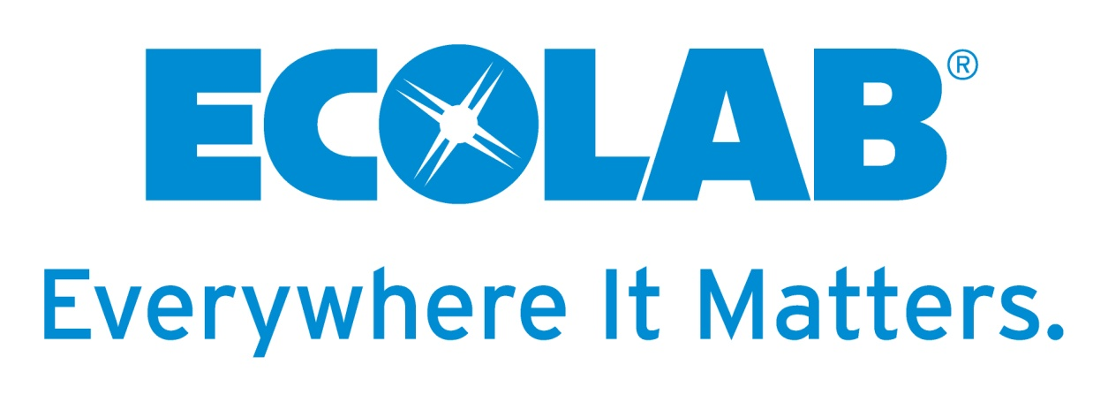

Thank You!
Any Questions?

