Slide 1

FDA Menu Labeling
Environmental Management Department
Presented by Elena Drobenyuk

Slide 2
Why Menu Labeling?
2/3 of adult population is overweight or obese
1/3 of calories consumed outside the home
Information on calories generally not available at point of purchase in restaurants and similar retail food establishments
One tool to help people maintain healthy weight

Slide 3
Background
California SB 1420 - July 1, 2009
Affordable Care Act (ACA) enacted – March 23, 2010
  Section 4205, Amends FD&C Act 403(q)5(H)
FDA issued proposed rule in 2011 (received ~ 900 comments)
California SB 20 – 2011
Issues final rule on December 1, 2014
  Menu labeling compliance date – December 1, 2015
  Implementation has been delayed three times
FDA Compliance Date: May 7, 2018
Federal law allows FDA to impose monetary penalties and/or jail time for violations of the Food, Drug and Cosmetic Act (FDCA).
Notes:
Workshops July-November 2016; opened comments period. The national nutrition labeling regulations were first announced in late 2014 and were originally supposed to be implemented in December 2015, but have been delayed three times because of industry concerns that the requirements were too difficult and confusing.

Slide 4
Covered Establishments
Restaurants or similar retail food establishments (SRFE) that offer for sale “restaurant type food”
Exempt: Schools, food trucks, sidewalk carts, trains, airplanes, hotels with complimentary breakfast, and in-patient only food service facilities located in hospitals
Includes: Restaurants, grocery and convenience stores, cafeterias, superstores, and entertainment venues (e.g. movie theaters, amusement parks)
Part of a chain with 20 or more locations (regardless of the type of ownership)
Doing business under the same name
Offering for sale substantially the same menu items

Slide 5
What Does the Law Require?
Disclose calorie information on menus and menu boards for standard menu items
Disclose calorie information on signs adjacent to foods on display and self-service foods that are standard menu items
Post a succinct statement concerning suggested daily caloric intake
“2,000 calories a day is used for general nutritional advice, but
calorie needs vary”
Post on menu and menu boards statement that written nutrition information is available upon request
‘‘Additional nutrition information available upon request’’
Provide written nutrition information for standard menu items upon consumer request

Slide 6
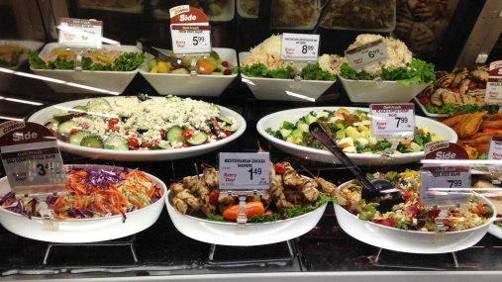

Examples of Foods Not Considered Restaurant-Type Foods
Bulk foods (e.g., dried fruit, nuts)
Foods eaten over several eating occasions or stored for later use (e.g., loaves of bread, bags or boxes of dinner rolls, whole cakes, and bags or boxes of candy or cookies)
Foods that are usually further prepared before consuming (e.g., deli meats and cheeses)
Foods that are not self-service and not intended solely for an individual consumption (e.g., deli salads, items sold by weight)

Slide 7
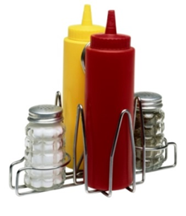
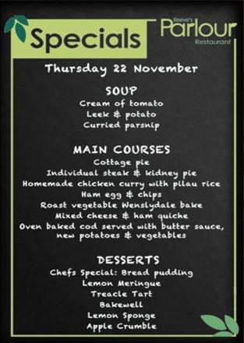
Foods that are Exempt
Custom orders, which are prepared in a specific manner at the customer’s request
Daily specials, foods that are not routinely listed on the menu and are promoted as a special menu item for that day
Temporary menu items, which appear on a menu or menu board for less than a total of 60 days per calendar year
Condiments available for general use, including those placed on the table or on or behind the counter (e.g., flasks of pancake syrup on the table)
Customary market test items, that are offered for fewer than 90 consecutive days to test consumer acceptance
Foods that are not on a menu or menu board and are not on display or self-service (these foods are not considered “standard menu items”)

Slide 8
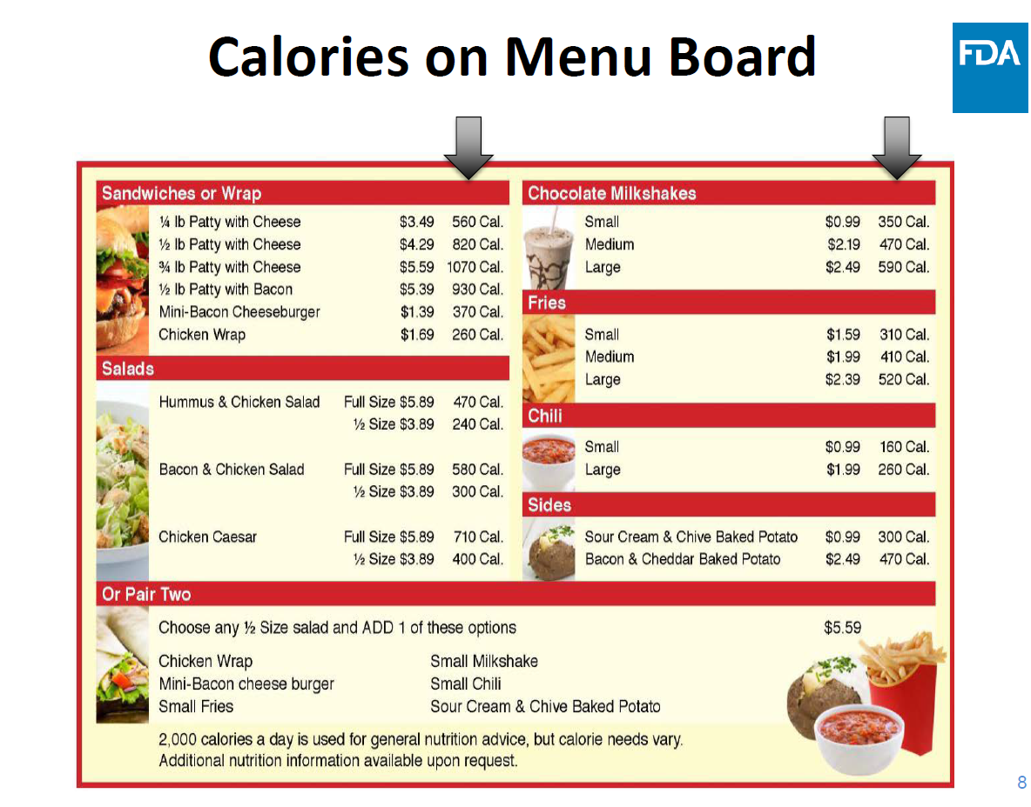

Slide 9
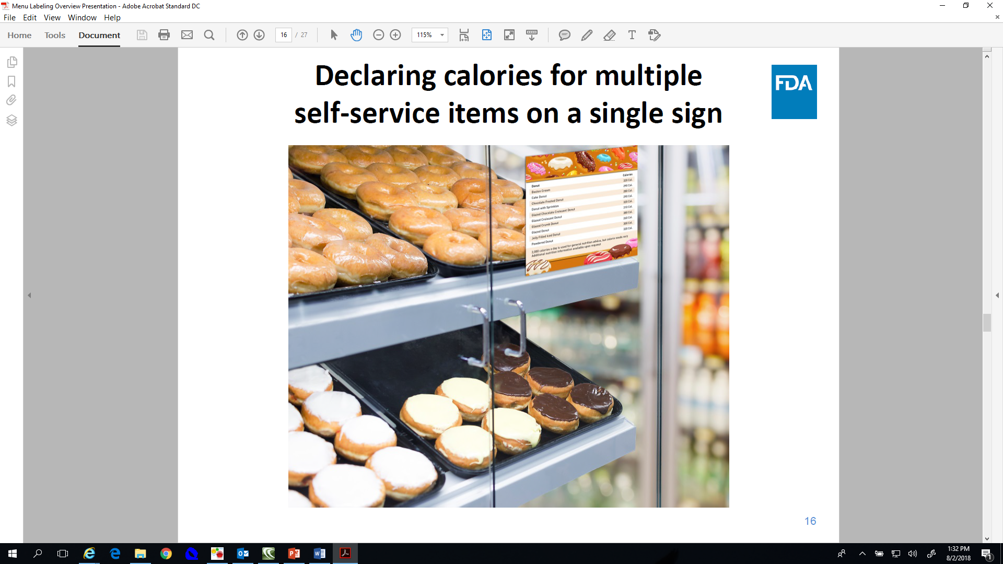
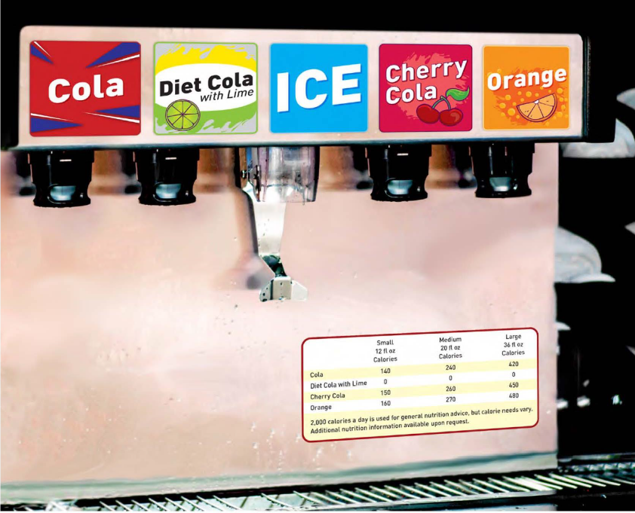
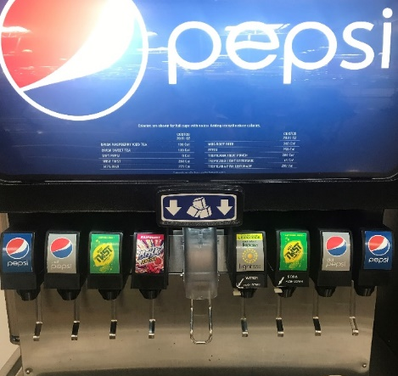
Calorie Declarations for Foods on Display
If foods on display are also listed on the menu or menu board they must
  Meet the requirements for declaration of calories on menus and menu boards AND
  Meet the requirements for foods on display
  Ask yourself, “can the customer view posted calories while making their selection?”

Slide 10
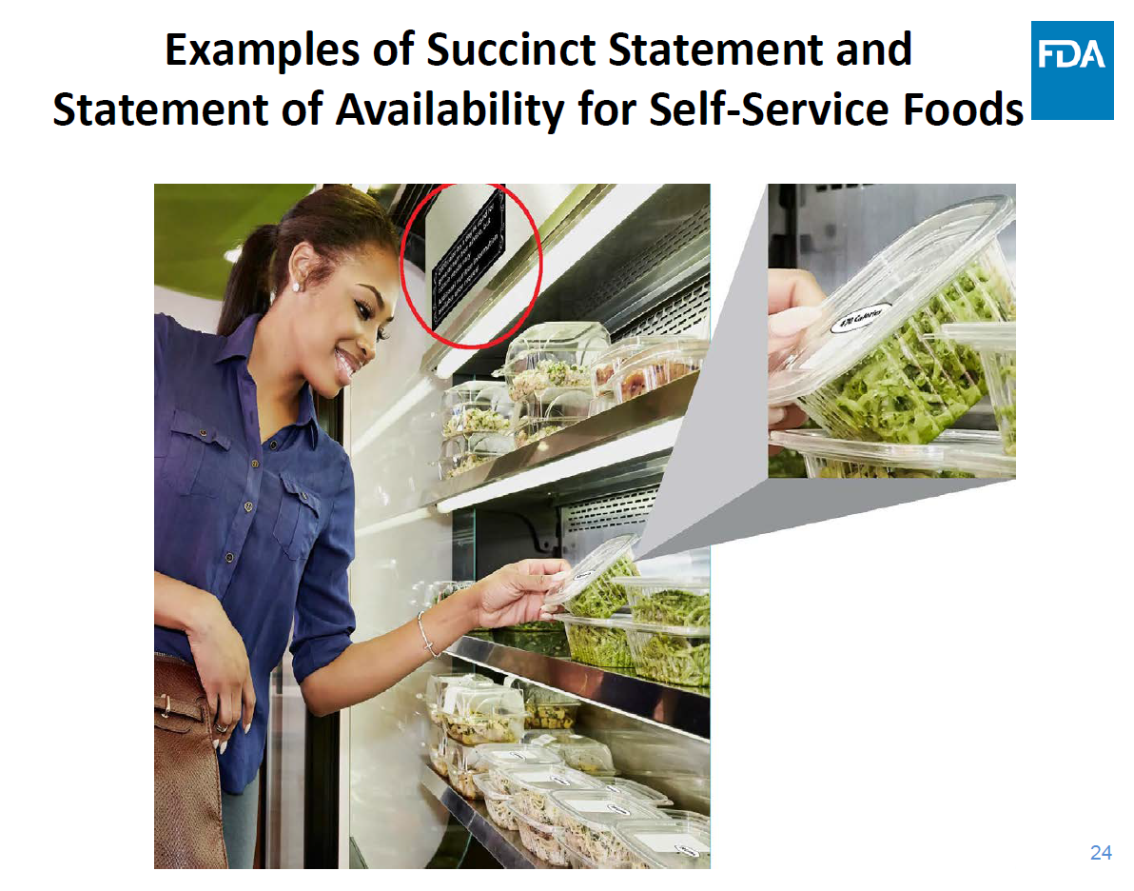

Slide 11
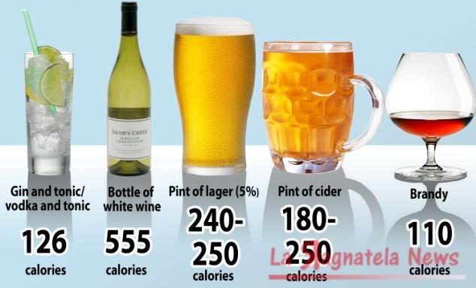
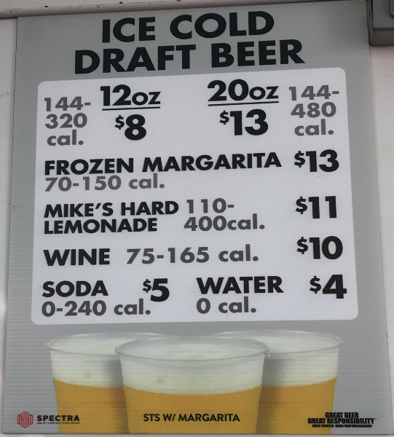
Alcohol
Covered establishments must disclose calories and other nutritional information for alcoholic beverages that are on menus and menu boards
Exemption: alcohol that is on display behind the bar (and not on the menu, menu board, or not self-service)
FDA consider that beers on Keg taps to be alcoholic beverages that are foods on display (exempt)

Slide 12
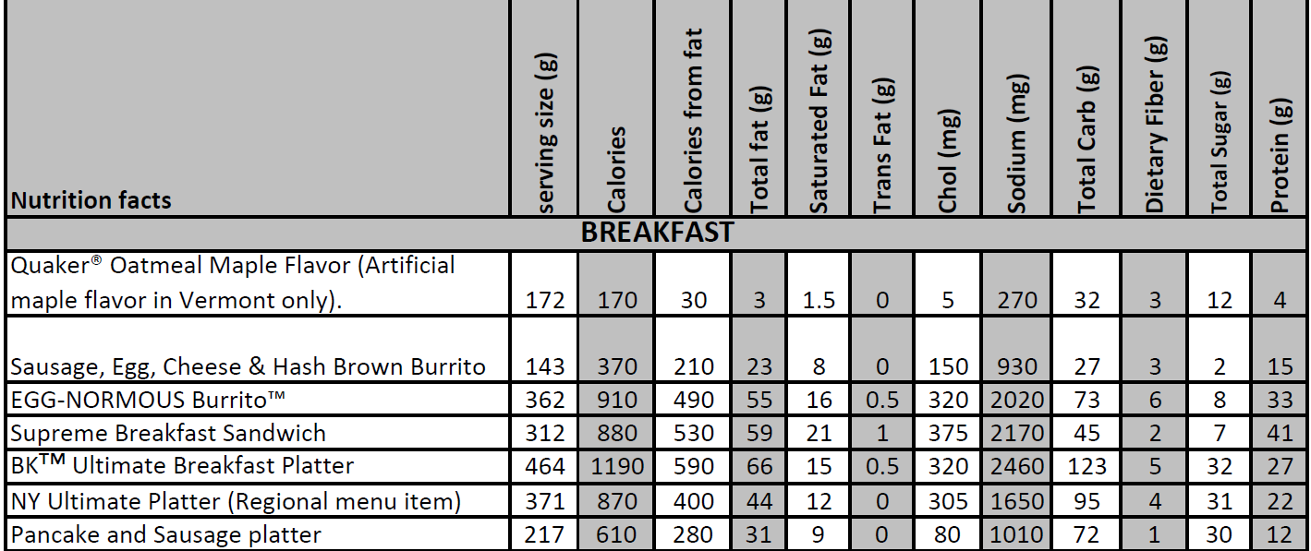
Written Nutrition Information
Must be available in written form and provided or readily available to the customer upon request
The information must be presented in a clear and conspicuous manner likely to be read and understood by the ordinary individual under customary conditions of purchase and use

Slide 13
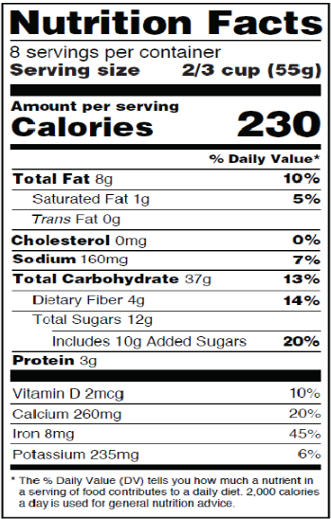
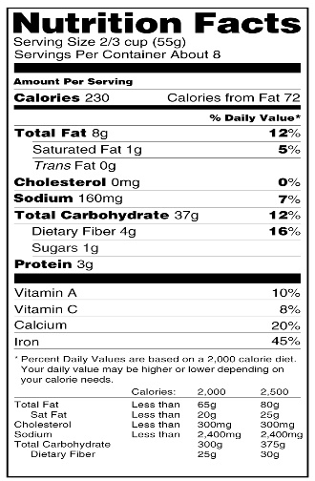

Determining Nutritional Content
Covered establishments must have reasonable basis for its nutrient content declarations
Nutrient values can be determined by:
  Cookbooks
  Laboratory analysis
  Nutrient databases
  Nutritional Facts labels
  Other reasonable means
Upon FDA request, covered establishments must provide information substantiating their nutrient values. Two signed/dated statements are needed to:
  Certify that nutrient analysis is accurate and complete, and
  Certify that the facility has taken reasonable steps to ensure the method of preparation and amount of the standard menu items adhere to the factors on which its nutrient values were determined

Slide 14
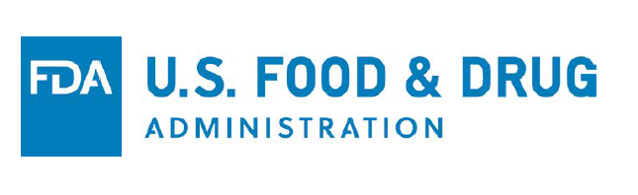
Resources
The final rule is available online at FDA.gov at: https://www.gpo.gov/fdsys/pkg/FR-2014-12-01/pdf/2014-27833.pdf
Issued May 2018 - Guidance for Industry: https://www.fda.gov/downloads/Food/GuidanceRegulation/GuidanceDocumentsRegulatoryInformation/UCM583492.pdf
Issued April 2016 - Guidance for Industry: http://www.fda.gov/downloads/Food/GuidanceRegulation/GuidanceDocumentsRegulatoryInformation/UCM461963.pdf
Issued March 2015 - Compliance Guide: http://www.fda.gov/downloads/Food/GuidanceRegulation/GuidanceDocumentsRegulatoryInformation/UCM437566.pdf
Sacramento EMD (916) 875-8440

Slide 15

Questions?

