Slide 1
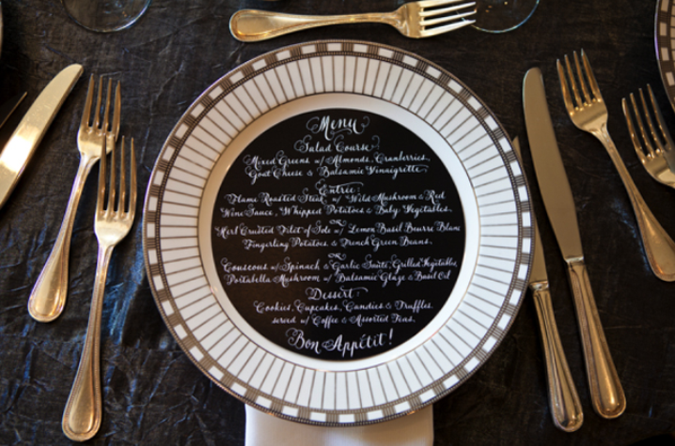
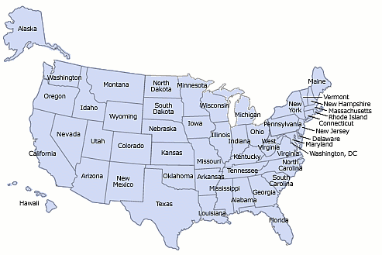
FDA FINAL RULE ON
MENU LABELING
Presented by Sacramento County

Slide 2
History and Legislation
SB 1420 - July 1, 2009
Affordable Care Act – March 2010
  Section 4205, Amends FD&C Act 403 (q)5(H)
Final Rule – Dec 1, 2014
  21 CFR Part 101, Section 101.11

Slide 3
Why Menu Labeling?
2/3 of adult population is overweight or obese
1/3 of calories consumed outside the home
Information on calories generally not available at point of purchase in restaurants and similar retail food establishments
One tool to help people maintain health weight
FDA–2011–F–0172
Notes:
Reference: http://www.fda.gov/downloads/Food/IngredientsPackagingLabeling/LabelingNutrition/UCM423985.pdf
(Refs. 75;76;77).

Slide 4
Starting December 1, 2015
Covered establishments are required to disclose in a clear and conspicuous manner:
On menus and all menu boards:
  the number of calories for each standard menu item;
  a succinct statement concerning suggested daily caloric intake; and
  a statement indicating that additional nutrition information is available upon request
b. Additional nutrition information for standard menu items available to the costumer upon request
c. For standard menu items that are food on display or for self-service, the number of calories contained in each item or per serving.

Slide 5
Covered Establishments
Restaurants or similar retail food establishments that are:
Exempt: Schools, food trucks, hotels, trains and airplanes
*Includes: Restaurants, grocery stores, and similar retail food establishments (SRFEs)
Part of a chain with 20 or more locations (regardless of the type of ownership)
Doing business under the same name
Offering for sale substantially the same menu items
§ 101.11 (a)

Slide 6
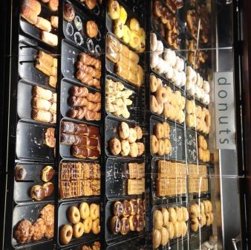
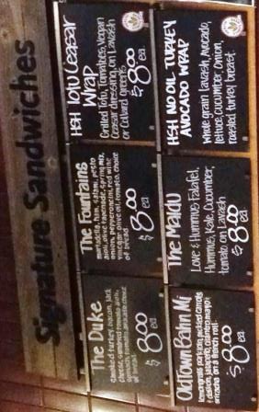
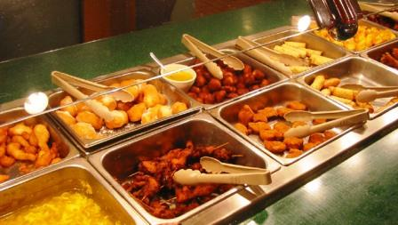
Foods That Are Covered
Food for immediate consumption at a sit-down or quick service restaurant
Food purchased at a drive-through establishment
Take-out and delivery pizza; hot pizza at grocery and convenience stores that is ready to eat; pizza slice from a movie theater
Hot buffet food, hot soup at a soup bar, and food from a salad bar
Foods ordered from a menu/menu board at a grocery store intended for individual consumption (e.g., soups, sandwiches, and salads)
Self-service foods and foods on display that are intended for individual consumption (e.g., sandwiches, wraps, and paninis at a deli counter; salads plated by the consumer at a salad bar; cookies from a mall cookie counter; bagels, donuts, rolls offered for individual sale)

Slide 7
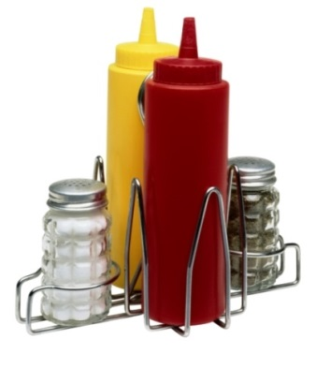
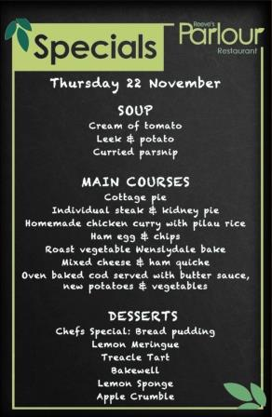
Foods That Are Exempt
Custom orders, which are prepared in a specific manner at the customer’s request
Daily specials, foods that are not routinely listed on the menu
Temporary menu items, which appear on a menu or menu board for less than 60 days per calendar year
Customary market test items, that are offered for fewer than 90 consecutive days to test consumer acceptance
Condiments available for general use, including those placed on the table or on or behind the counter
§ 101.11 (b)(1)(ii)

Slide 8
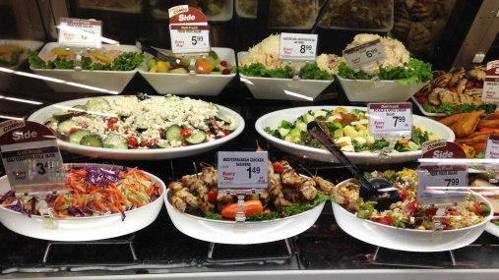
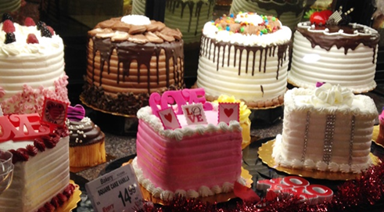
Examples of Foods That Are Exempt
Certain foods bought from bulk bins or cases (e.g., dried fruit, nuts) in grocery stores
Foods to be eaten over several eating occasions or stored for later use (e.g., loaves of bread, bags or boxes of dinner rolls, whole cakes, and bags or boxes of candy or cookies)
Foods that are usually further prepared before consuming (e.g., deli meats and cheeses)
Foods sold by weight that are not self-serve and are not intended solely for individual consumption (e.g., deli salads sold by weight such as potato salad, chicken salad), either prepacked or packed upon consumer request

Slide 9
Declaring Calories on the
Menu or Menu Board
The number of calories contained in each standard menu item listed, as usually prepared and offered for sale.
In the case of multiple-serving, the calories declared must be:
  For the whole menu item listed, as usually prepared and offered for sale (e.g. “pizza pie: 1600 cal”)
Or
  Per discrete serving unit as long as the discrete serving unit (e.g., pizza slice) and total number of discrete serving units contained in the menu item are declared (e.g.“pizza pie: 200 cal/slice, 8 slices”)
§ 101.11 (b)(2)(i)(A)
Notes:
Post calories per slice as long as they also list how many slices per pie

Slide 10
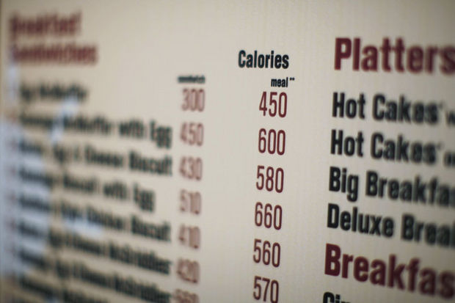
The Calories For Standard Menu Items Must be Declared in the Following Manner:
The number of calories must be listed adjacent to the name or the price, in a type size no smaller than the type size of the name or the price, whichever is smaller.
Number of calories must be declared to
  5-calorie increment – 50 calories
  10-calorie increment > 50 calories
The term “Calories” or “Cal” must appear as a heading above a column listing the number of calories.
§ 101.11 (b)(2)(i)(A)(1-3)
Notes:
Less than 5 calories may be expressed as zero.

Slide 11
Additional Requirements That Apply to Each Individual Variable Menu Item:
The calories must be declared separately for each listed flavor or variety (e.g. “ice cream, dips, doughnuts”).
When flavors or varieties have the same calorie amount (after rounding), the calorie declaration can be listed as a single calorie declaration.
When a menu does not list flavors or varieties but only includes a general description (e.g. “soft drinks”), the calories must be declared:
  with a slash between two options (e.g. “150/220”)
  or
  with a range where more than two options are available (e.g. “150-220”)
§ 101.11 (b)(2)(i)(A)(4)

Slide 12
When menu lists toppings that can be added to a menu item:
The calories must be declared for the basic preparation of the menu item as listed (e.g., ‘‘small pizza pie,’’ ‘‘single scoop ice cream’’).
The calories must be separately declared for each topping listed (e.g., pepperoni, sausage, green peppers, onions on pizza; fudge, almonds, sprinkles on ice cream).
  Specifying that the calories are added to the calories contained in the basic preparation of the menu item.
The calories for each topping listed on the menu or menu board must be declared for each size of the menu item, or declared as a range.
Cheese Pizza: small (12”) 400 Cal, Medium (14”) 650 Cal, Large (16”) 900 Cal
Toppings | Added Cal (S/M/L)
Pepperoni………… Sausage……………. Green Peppers…. Onions……………… | 200-400 250-450 15-25 20-30
§ 101.11 (b)(2)(i)(A)(5)

Slide 13
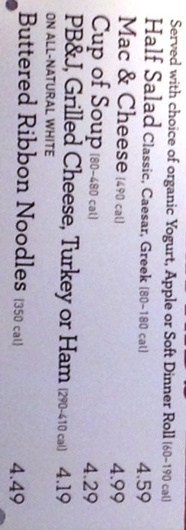
Additional Requirements That Apply to Each Individual Combinational Menu Item:
If only 2 options (e.g., a sandwich with fries or with fruit), provide both numbers with a forward slash between (e.g., 350/450).
If three or more options are available (e.g., a sandwich with chips, a side salad or fruit cup) provide the range in calories (e.g.,“450-550 calories”).
These top bullets do not apply, when a customer combines standard menu items for a specific price (e.g., ‘‘Combine Any Sandwich with Any Soup or Any Salad for $8.99’’) and the calories for each standard menu item are already listed on the menu or menu board.
§ 101.11 (b)(2)(i)(A)(6)

Slide 14
All-You-Can-Eat Buffet
Establishment must place a sign adjacent to the food with number of calories per item or serving
AND
Adjacent to the name or price of the item, the menu/menu board must include a statement, e.g., ‘‘See buffet for calorie declarations.’’
§ 101.11 (b)(2)(i)(A)(8)

Slide 15
The Following Must be Provided For Each Standard Menu Item That is Self-Service or on Display
Calories per displayed food item (e.g., a bagel, per slice,) or calories per serving (e.g., scoop, cup, ladle) if food is not offered for sale in a discrete unit
  Example: 150 calories per scoop
If it is not clear to which food the calorie declaration and serving unit refers, then the sign must also include the name of the food
  Example: broccoli and cheese casserole – 200 calories per scoop
A sign can be attached to a sneeze guard or on placard that is easily visible and a customer can view all of the information while selecting that item
Self-service beverage must be posted in total number of “fluid ounces” in a cup and, if applicable, the description of the cup size
  Example: 140 calories per 12 fluid ounces (small)
Two nutritional statements may appear on the sign adjacent to the food itself or on a separate, larger sign and must be clearly visible as the consumer is viewing the food
§ 101.11(b)(2)(iii)

Slide 16
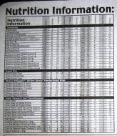
Nutritional Information
‘‘Additional nutrition information available upon request’’
  For menus, statement must be posted on the bottom of the first page along with succinct statement
  For menu boards, statement must be posted along with succinct statement
  Written nutritional information may be provided on a counter card, sign, poster, handout, binder, booklet or electronic device (computer), or …
“2,000 calories a day is used for general nutritional advice, but calorie needs vary.”
“Additional nutritional information available upon request.”
§ 101.11(b)(2)(i)(C)

Slide 17
Establishments Must Disclose the Following Nutritional Information for Each Standard Menu Item
Must be available in written form and provided or readily available to the customer upon request.
This nutrition information must be presented in the order listed and using the measurements listed.
The information must be presented in a clear and conspicuous manner likely to be read and understood by the ordinary individual under customary conditions of purchase and use.
(1) Total calories (cal) (2) Calories from fat (fat cal) (3) Total fat (g) (4) Saturated fat (g) (5) Trans fat (g) (6) Cholesterol (mg) | (7) Sodium (mg) (8) Total carbohydrate (g) (9) Dietary fiber (g) (10) Sugars (g) (11) Protein (g)
§ 101.11(b)(2)(ii)(A) & (D)

Slide 18
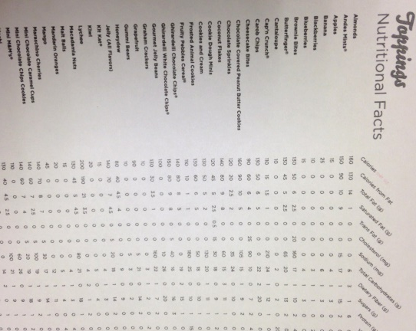
Nutritional Information for
Variable Menu Items
Must be declared separately for each topping, flavor, or variable component
All items that have the same calorie and nutrient values could be listed together only once.
§ 101.11(b)(2)(ii)(C)

Slide 19
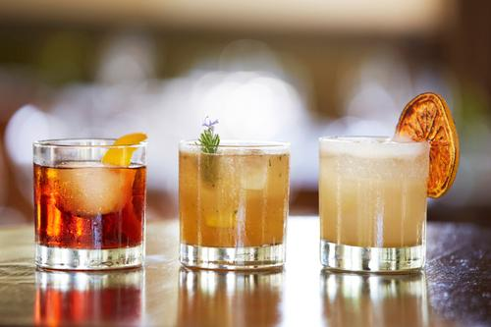
Alcohol
The final rule covers alcoholic beverages that are standard menu items that are listed on a menu or menu board
The rule exempts alcohol beverages that are foods on display and are not self-service foods (e.g., bottles of liquor behind the bar used to prepare mixed drinks)
The provisions of section 4205 of the ACA (Affordable Care Act) do not apply to and have no effect on the labels of food products sold in packaged form, including alcoholic beverages regulated by TTB (Treasury's Alcohol and Tobacco Trade and Tax Bureau).
§ 101.11(b)(1)(ii)(B)
Notes:
Alcoholic beverages are‘ ‘food’’ under the FD&C Act. The rules don't apply to drinks ordered at the bar or any drinks that aren't listed on the main menu. Facility would be able to use ranges of calories without listing the exact amount in every different drink.

Slide 20
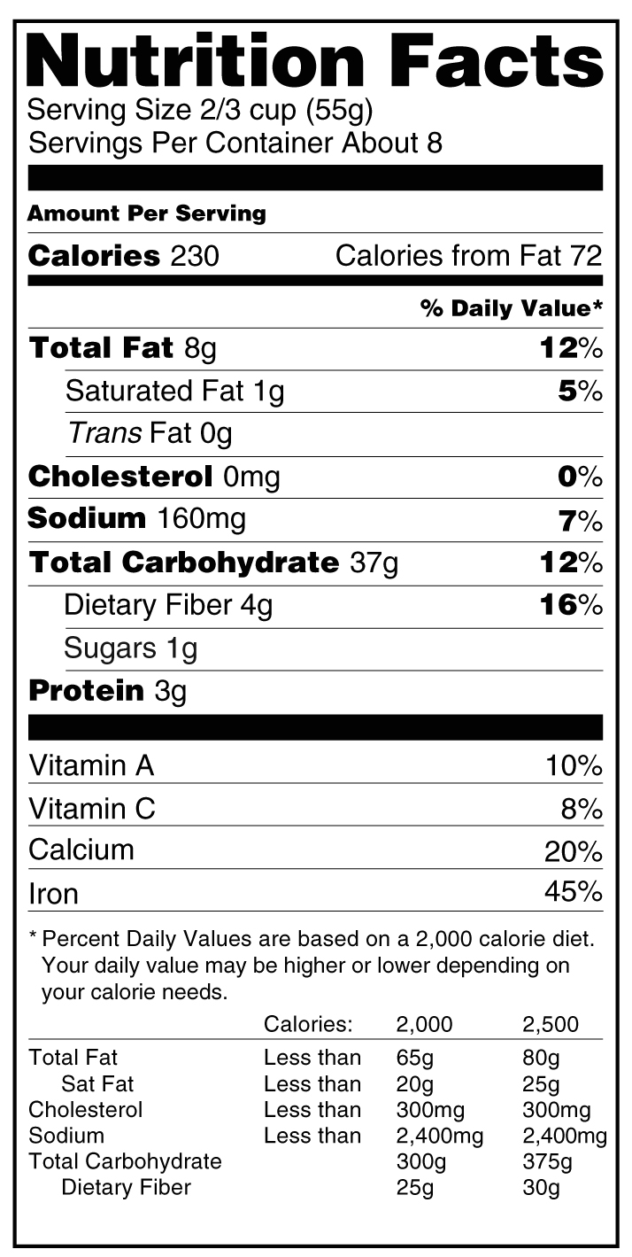

Determination of Nutrient Content
Reasonable basis and reasonable steps to ensure that the method of preparation and amounts are accurate
Nutrient values may be determined by:
  Cookbooks
  Laboratory analyses
  Nutrient databases
  Nutritional Facts Label
§ 101.11(c)

Slide 21


