Slide 1
Public health update sac environmental commission oct 2019
Olivia Kasirye, MD, MS
County Health Officer

Slide 2
Syndromic surveillance
NSSP Fact Sheet
Notes:
Syndromic surveillance can involve many data sources, including emergency departments, urgent care, pharmacy, poison control, etc.

Slide 3
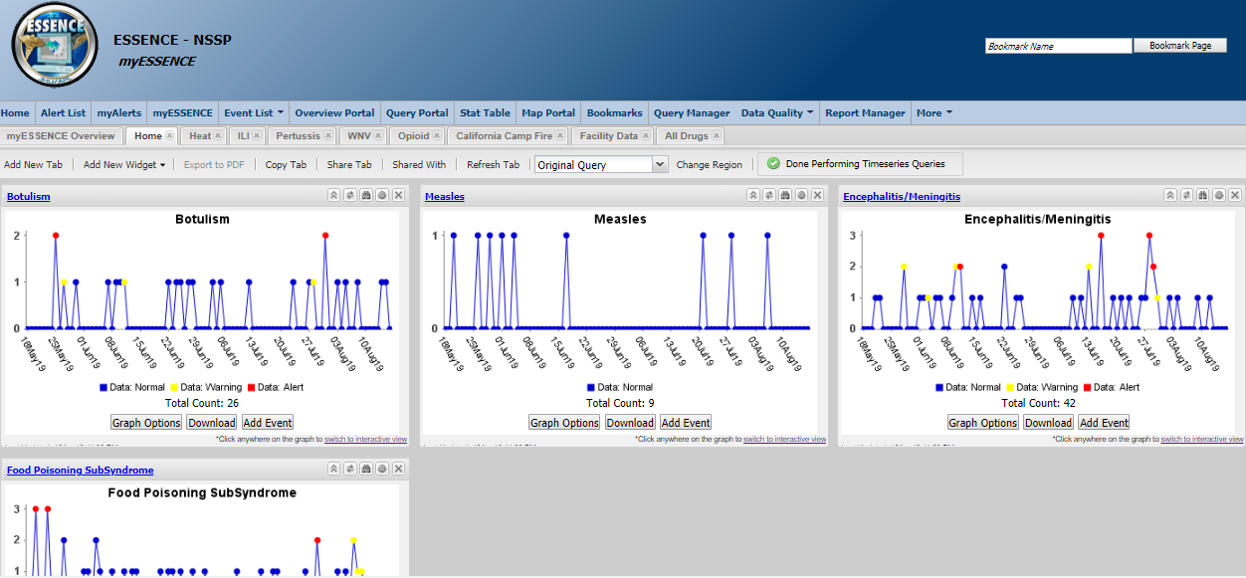
reportable diseases and conditions
Influenza-like Illness (ILI) syndrome
Measles
Pertussis
West Nile Virus
Botulism
Food poisoning subsyndrome
Encephalitis
Meningitis
Notes:
Initially focused on reportable diseases and conditions, looking for individual cases that may not have been reported and also possible outbreaks: measles, pertussis, WNV, ILI (used by most BioSense users)
Some determined during one of our CD-Epi meetings: encephalitis, meningitis
Botulism: 2017 outbreak with 10 cases, 4 from Sacramento
Dashboard with some of those queries

Slide 4
Influenza
ILI (syndrome) = influenza or (FeverPlus and (Cough or SoreThroat) and not NonILIFevers)
Influenza (subsyndrome) = flu, flulike, influenza, H1N1, swineflu, avianflu; not include stomach, shot, flu shot, vaccination, immunization
ICD-10: J09, J10, J11
Notes:
Influenza surveillance:
ILI syndrome (NSSP - CCDD)
Influenza subsyndrome (NSSP - CC)
ICD-10 discharge diagnosis codes for influenza
shows seasonal trend and peaks

Slide 5
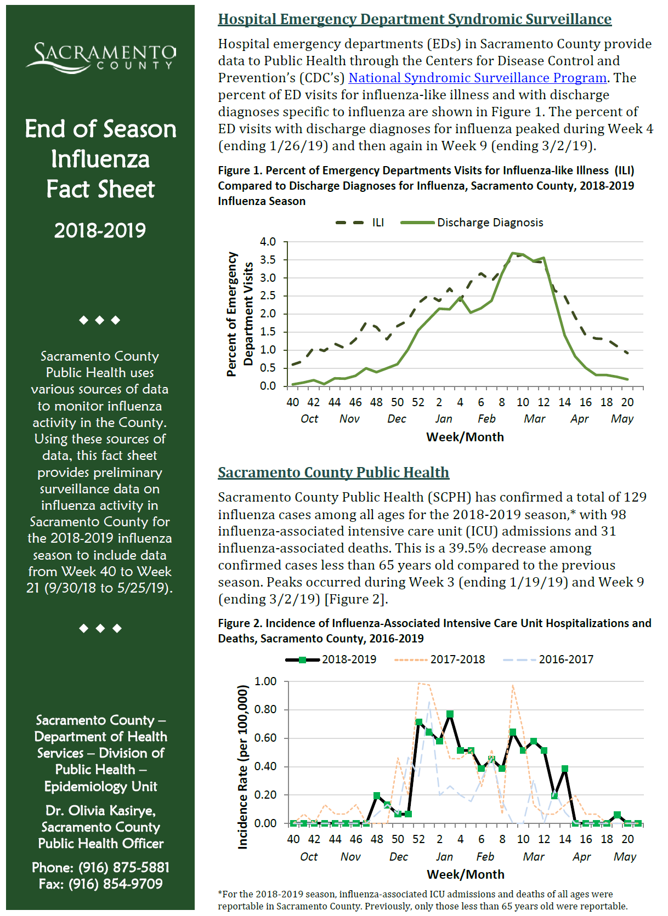
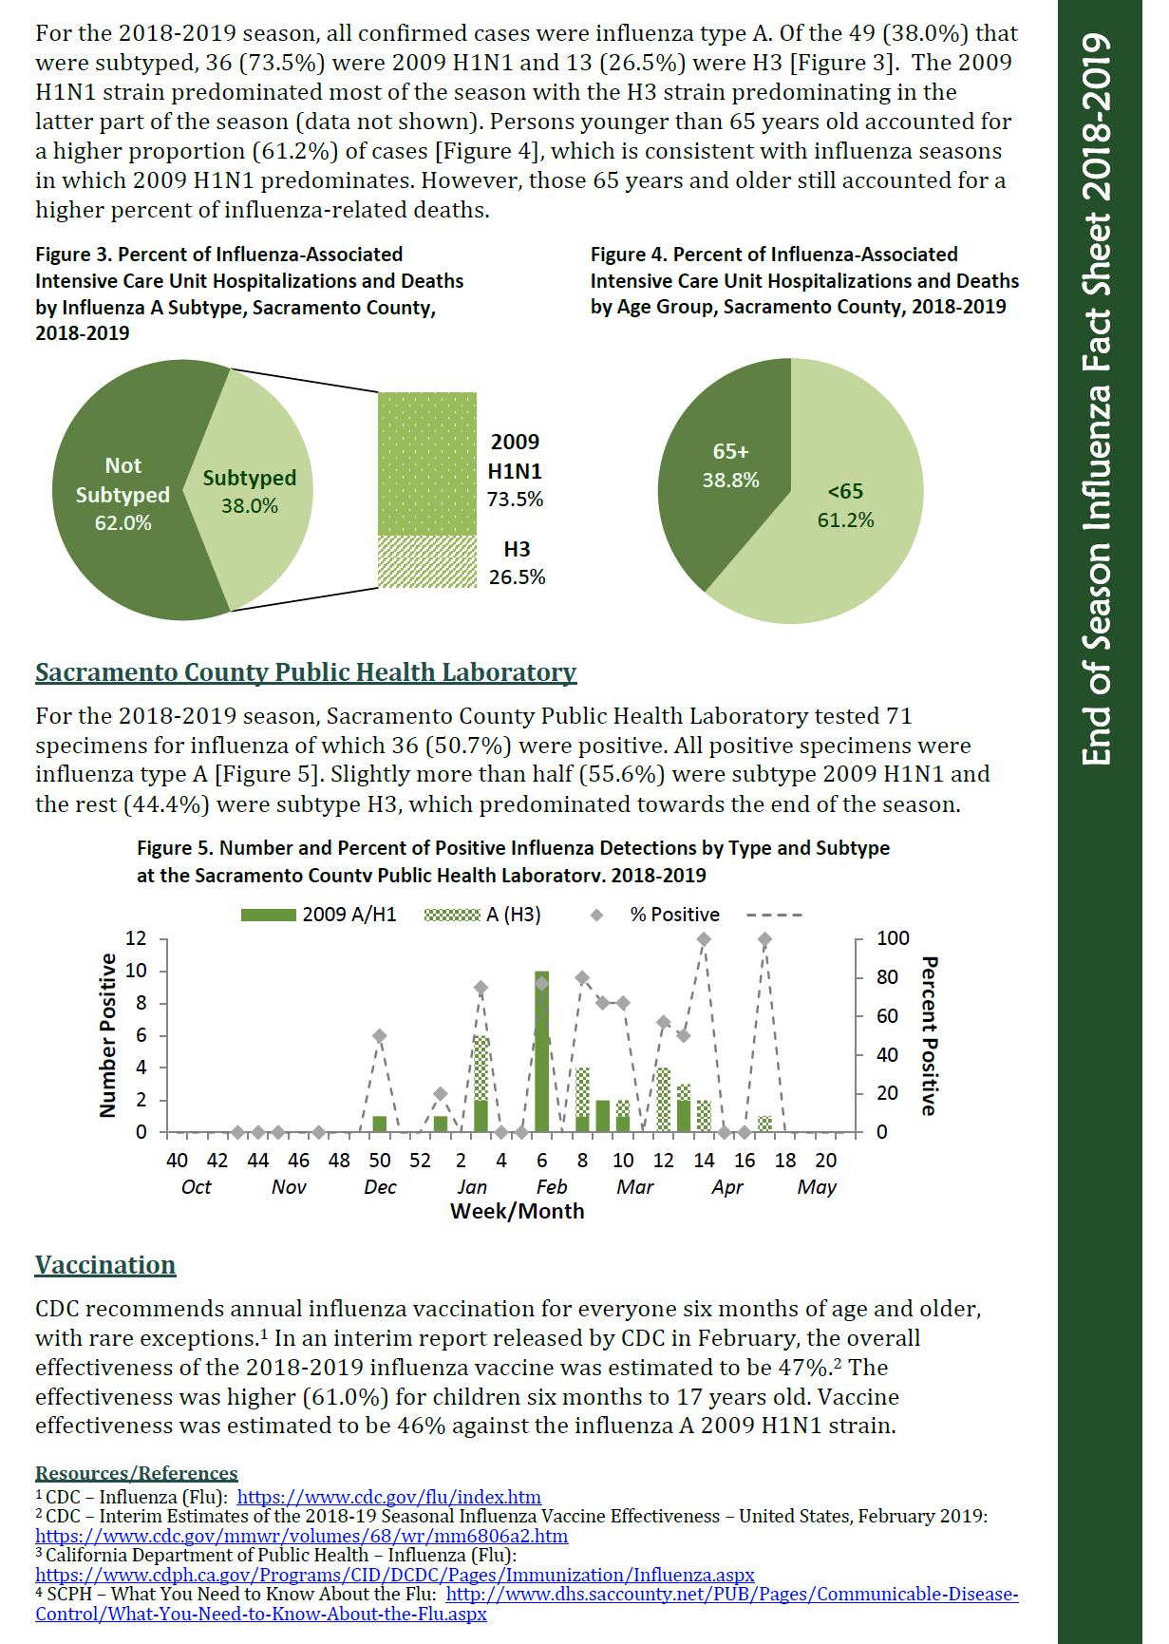
Influenza
Notes:
Create mid season and end of season flu fact sheets
Started incorporated syndromic surveillance data into flu fact sheet 2018-19 season as another source of data
Included ILI syndrome and ICD-10 code query
Initial peak Week 4 (Jan), another peak Week 10 (Mar) – closely matches our data from CalREDIE
Shared with some hospital IT folks who work with us on BioSense, happy to see that the data was being used

Slide 6
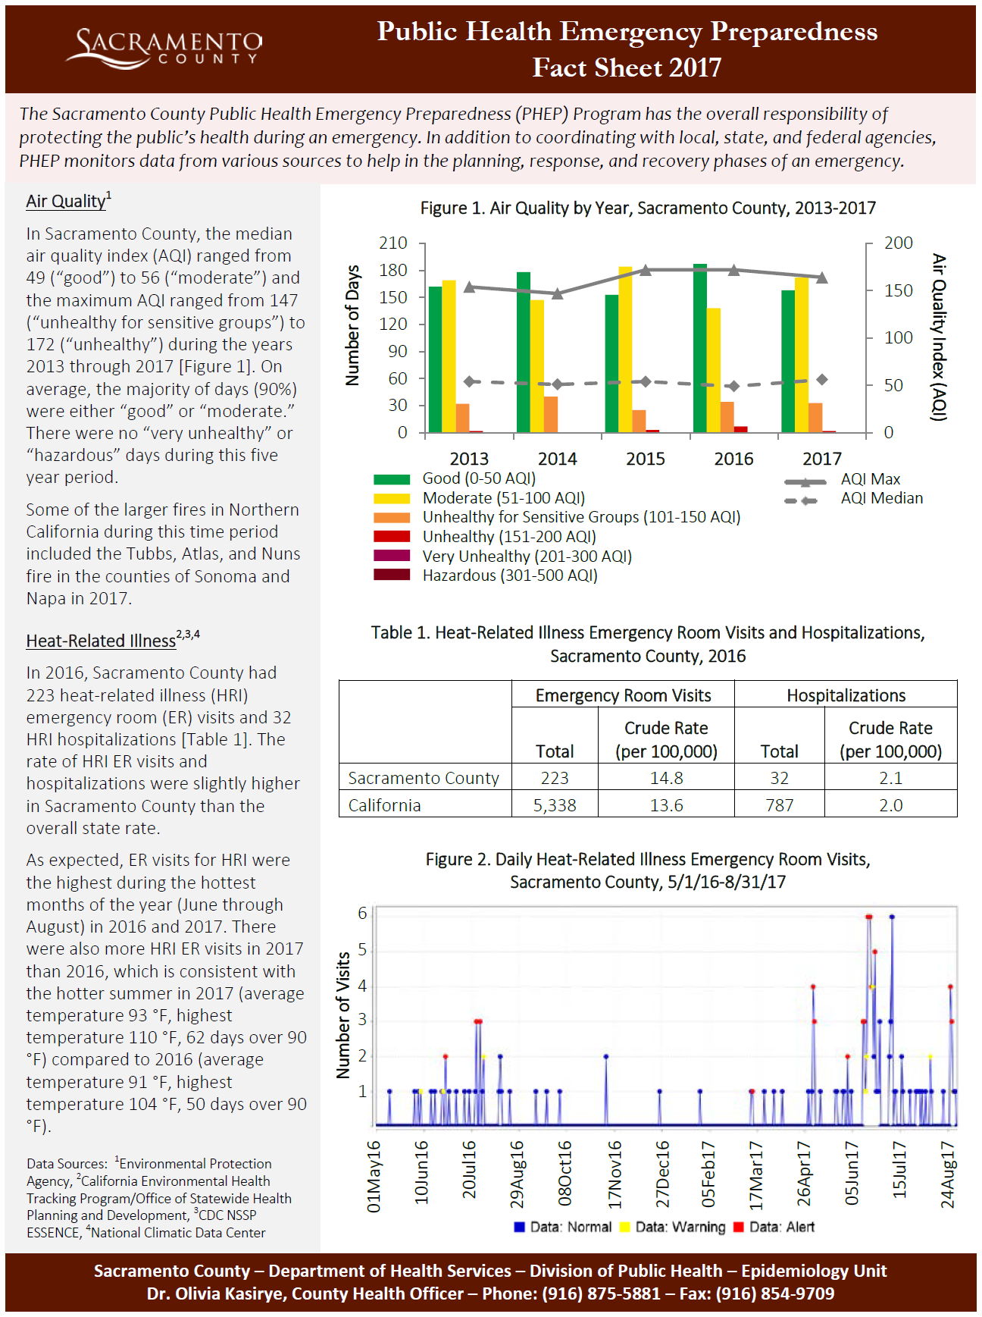
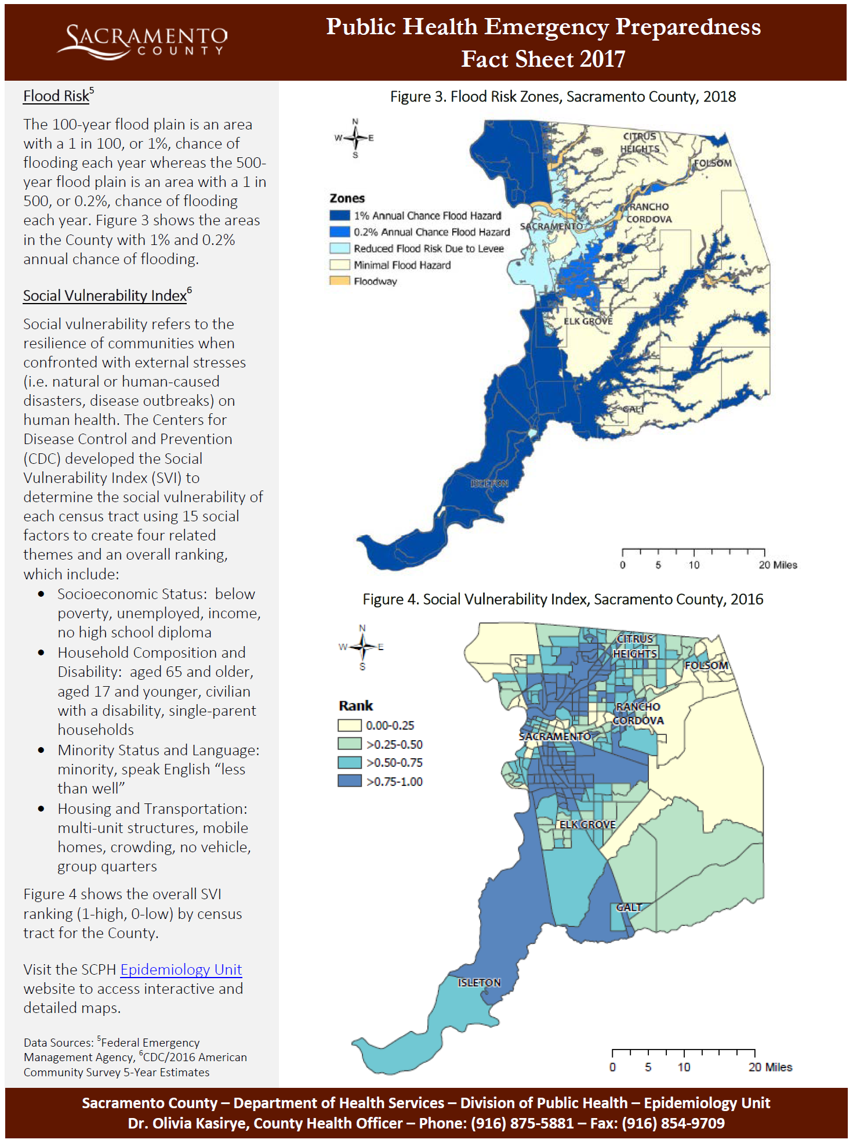
heat
Notes:
Started looking at heat using syndromic surveillance in 2018
Created a PHEP fact sheet looking at ED visits for heat-related illness:
compared 2016 vs. 2017 numbers
as expected, more visits for heat-related illness during the summer
more visits in 2017, consistent with hotter summer that year

Slide 7
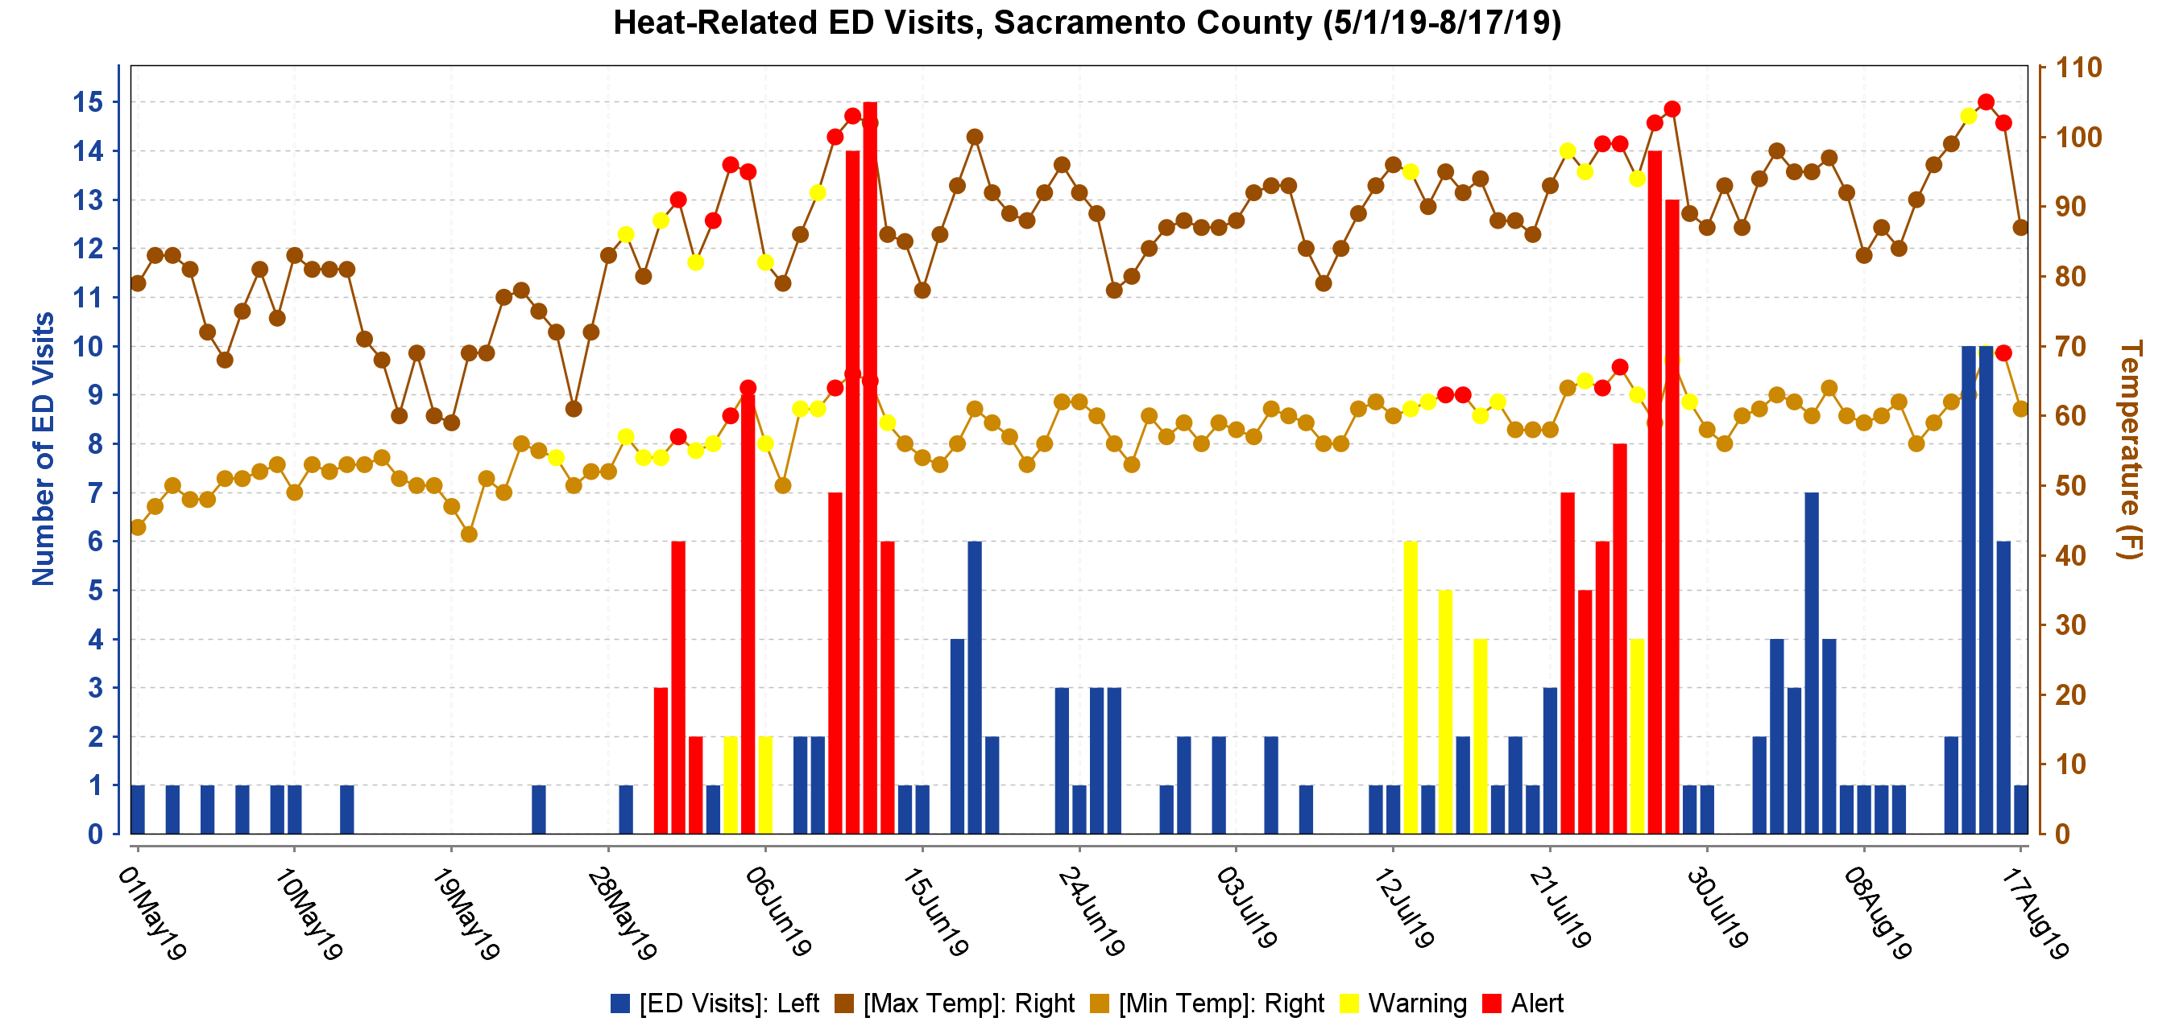
Heat – UPDATE GRAPH
Notes:
Updated query to include ICD-10 codes for “effects of light and heat”
saw more heat-related ED visits
previously max number of ED visits was 6 in a day, now up to 15

Slide 8
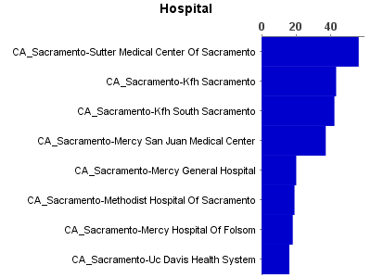
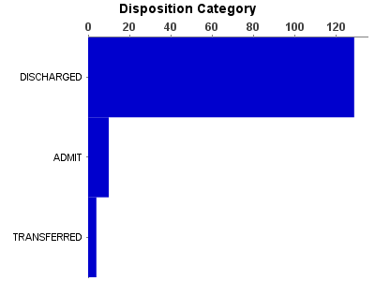
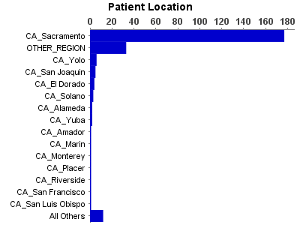
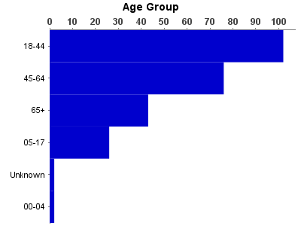
Heat
Notes:
Hospital
Disposition Category: most discharged (admissions may be due to with kidney-related disease)
Patient Location: patients from other counties
Age Group: larger age groups and by 10 year age groups, most visits among the younger population (in general, most ED visits were also among the younger age group)

Slide 9
Heat
Notes:
BioSense has a mapping capability
Broken down by zip code of residence:
does not include all visits (working with one hospital to provide 5 digit zip code, otherwise does not map correctly to Sacramento)
location of heat exposure could be somewhere else

Slide 10
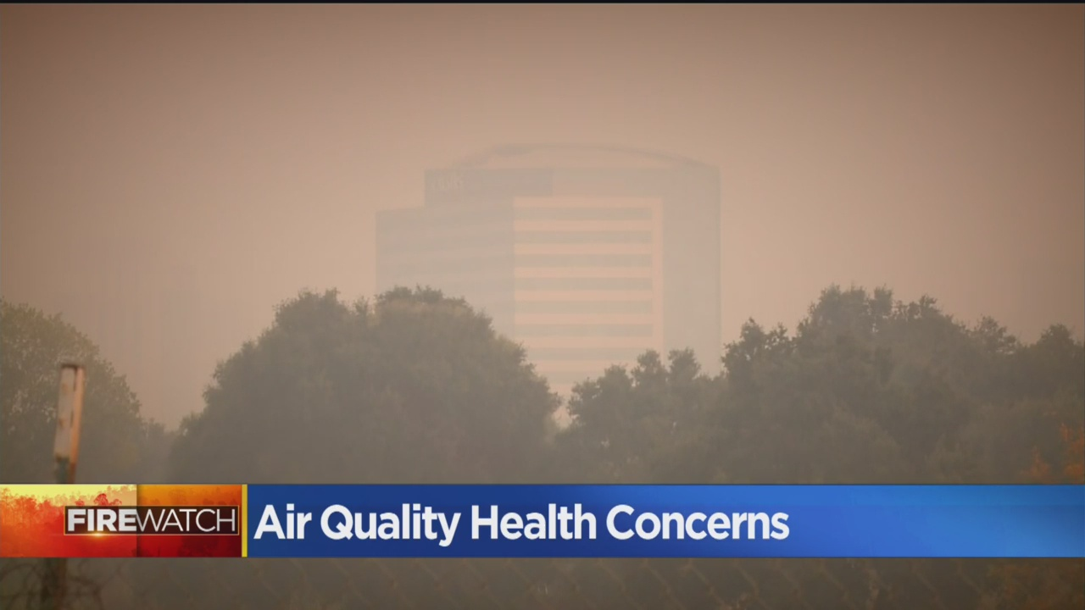
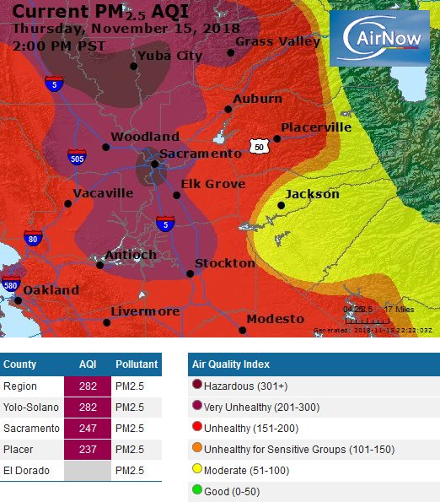
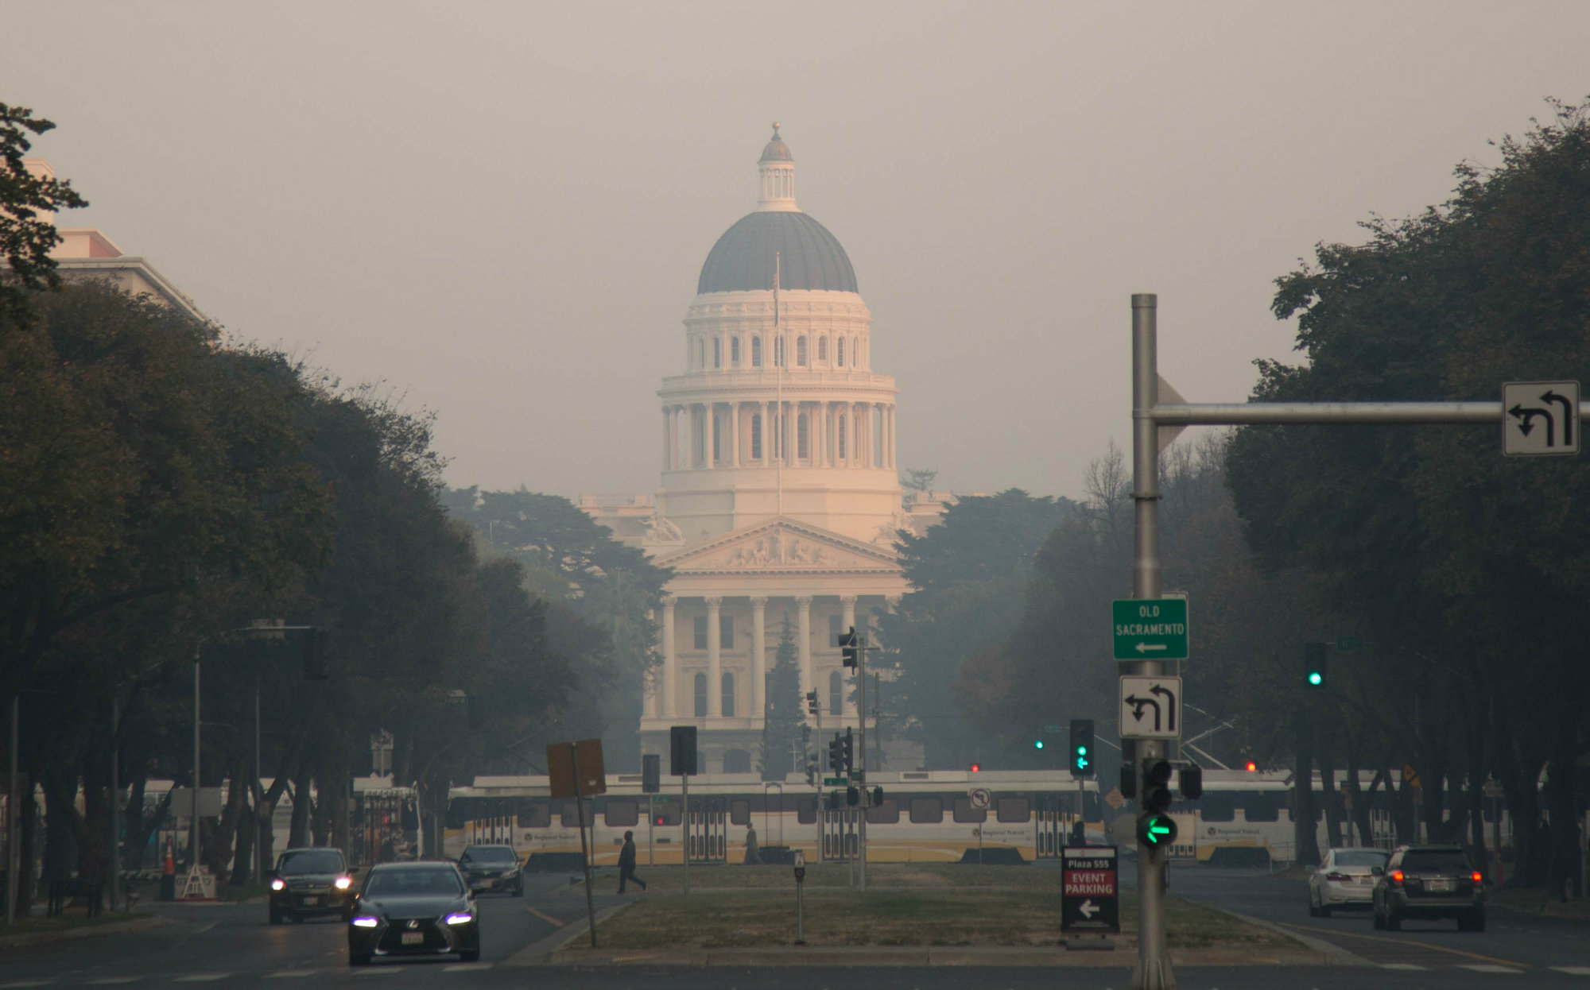
Wildfire smoke
CBS Sacramento
Capital Public Radio
Notes:
Camp Fire (Butte County):
started 11/8/18
contained 11/25/18 (18 days later)
Paradise only about two hours north of Sacramento
affected air quality from Sacramento to Bay Area
Sacramento had days of very unhealthy to hazardous air quality

Slide 11
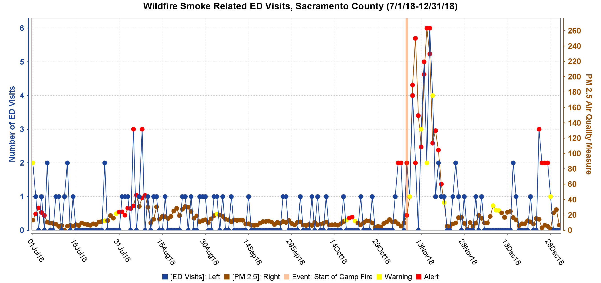
Wildfire smoke
Notes:
CDC contacted Sacramento to provide assistance:
- provided query for wildfire smoke related visits created by Washington state, modified slightly for Sacramento
Graph shows ED visits related to wildfire smoke (blue) overlaid with air quality (brown) and start of Camp Fire with the orange line:
increase in visits with poor air quality
Extended to July:
Carr Fire (Shasta County) started July 23
poor air quality days and increase in visits
air quality not as bad in the summer vs winter due to inversion layer

Slide 12
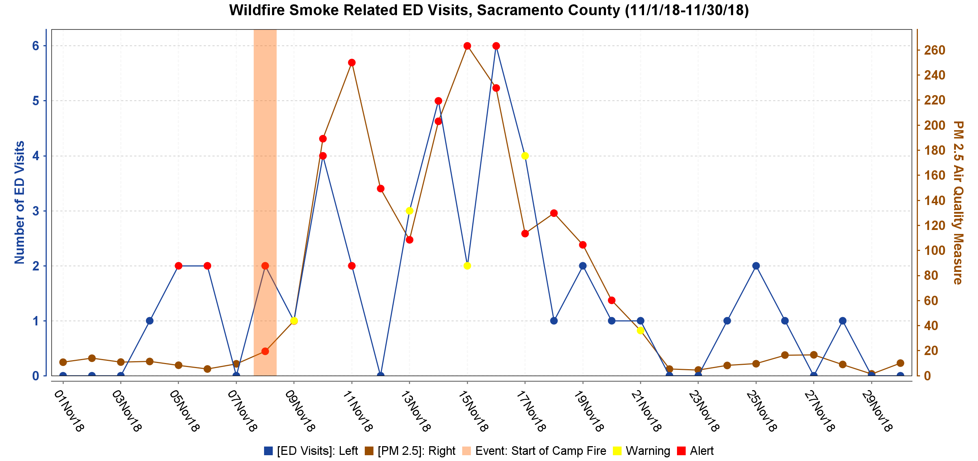
Wildfire smoke
Notes:
Focusing on November
Same: increase in ED visits with poorer air quality (mid-November)

Slide 13
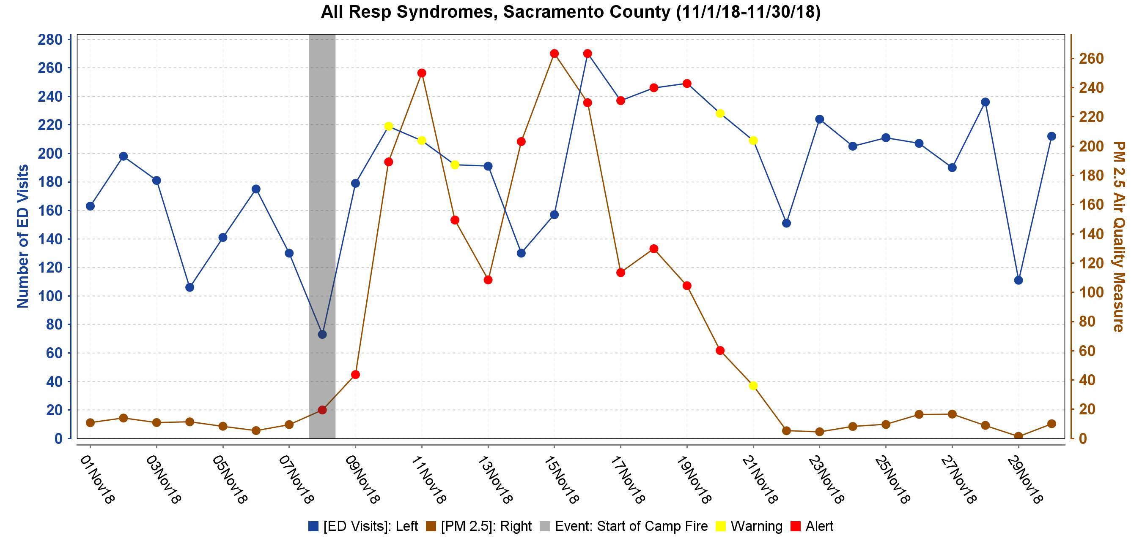
Wildfire smoke
Notes:
Increase in ED visits with poorer air quality (mid-November)

Slide 14
Mercury in face cream
Notes:
Certain skin-lightening or acne creams from Mexico have caused multiple cases of mercury poisoning throughout California. Cream users purchased the products on the street in California cities through informal networks of friends or they brought them into the USA from Mexico. These non-commercial creams are used for lightening the skin; fading freckles, blemishes, and age spots; and treating acne. Products usually come in plastic containers that either have no label or have hand-made labels. The poisoning cases have included several children and babies who were not cream users but who were exposed to mercury through contact with family members who used the products. The California Department of Public Health’s Food and Drug Laboratory found creams to contain very high levels of mercury, up to 210,000 parts per million (ppm) or 21 percent. It is illegal to sell skin cream products in the USA that have 1 ppm or more of mercury.

Slide 15
Signs and symptoms of mercury poisoning
Notes:
Because signs and symptoms associated with inorganic mercury poisoning are non-specific in nature, cases may go undiagnosed for weeks or months, and misdiagnosis has led to clinical treatments that did not address the underlying poisoning.

Slide 16
Sacramento woman in semi-coma after using adulterated face cream
47-year-old Latino woman admitted to hospital with numbness in her hands and face, gait disturbances and slurred speech, which continued to worsen over the course of a few weeks and became unconscious
was found to have a blood mercury of 2,630 μg/L. Normal values are less than 5 μg/L. Her initial mercury urine levels were 120 μg/L.
The cream she was using had 12,000 ppm of methyl mercury
Typically creams contain mercury salts, such as mercurous chloride.

Slide 17
Public health response
Warnings in the media to the public about about use of creams with added ingredients
Outreach and education to the community
Testing of creams brought in by community members
Encourage testing for anyone with symptoms

Slide 18
Respiratory illnesses and deaths related to vaping

Slide 20
Vaping associated pulmonary injury

Slide 21
Vaping associated pulmonary injury

Slide 23
Counties/cities Ban Flavored Tobacco Products

Slide 24
THANK YOU
Olivia Kasirye, MD, MS
https://dhs.saccounty.net/PUB/Pages/Epidemiology/SP-Epidemiology.aspx

