Slide 1
THE NORTH FRANKLIN SOLAR PROJECT
September 2018

Slide 2
HIGHLIGHTS
COMMUNITY RESOURCE PROJECT

Slide 3
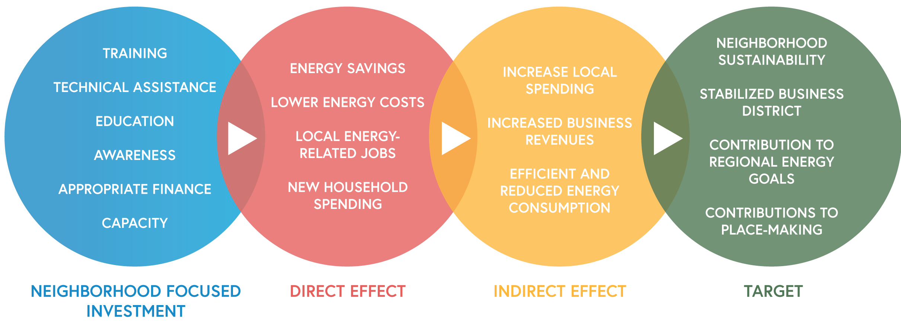
BENEFITS
COMMUNITY RESOURCE PROJECT

Slide 4
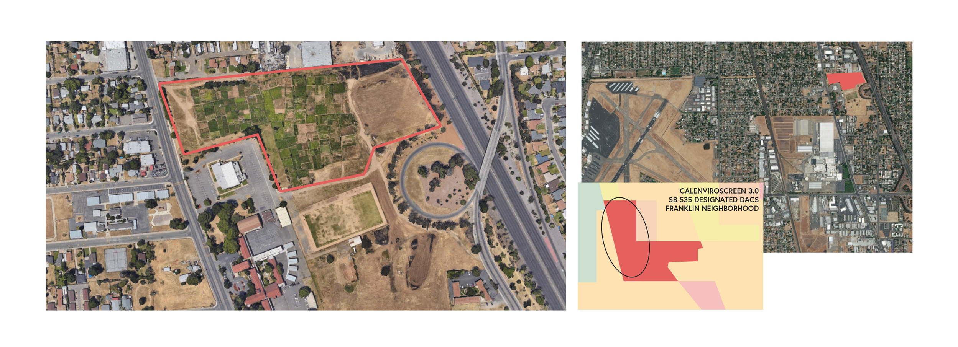
LOCATION
CONSTRUCTION LOCATION
NORTH FRANKLIN NEIGHBORHOOD
5961 FRANKLIN BLVD.
COMMUNITY RESOURCE PROJECT

Slide 5
Supporters for the Community Solar Project (Partial list)
Senator Richard Pan
Supervisors Patrick Kennedy and Phil Serna
SMUD
Sacramento City Councilman Jay Schenirer
Dr. Kasirye, Dept of Health & Human Services
Sacramento Metro Air Quality Management District
Local Government Commission, Kate Mais
Green Tech, Simeon Grant
Capitol Region Climate Readiness Collaboration, Kathleen Ave
Franklin Business District and La Familia
COMMUNITY RESOURCE PROJECT

