Slide 1
Recyclables and Organics Update Sacramento Environmental Commission March 18, 2019 Tim Israel, Superintendent

Slide 2
Presentation Overview
Who is DWMR?
Single Stream Recyclables – A Brief History
New SSR Contracts
Organics – What is organic waste?
SB 1383 – Draft Regulations
Potential Impacts
What DWMR is Doing in Preparation?

Slide 3
DWMR
Curbside collection from 153,000 single family/duplex homes in unincorporated areas of Sacramento County.
264 full time employees and 35 part time employees
Disposal Facilities
Kiefer Landfill
North Area Recovery Station
Residential services:
Weekly collection of garbage, used motor oil, used oil filters and cooking oil
Bi-weekly collection of recyclables
Bi-weekly collection of green waste
One no-cost calendar year bulky waste pickup by appointment
Illegal dumping clean up
Monthly street sweeping of residential areas using an outside contractor

Slide 4
Single Stream Recyclables – A Brief History
3 bin system implemented in summer 1991
Single Stream Recycling implemented in April 1998.
Materials were processed under a fixed price structure from 2006 until 2013.
In March 2013, two new processing contracts based on a market driven pricing structure with a floor price of $15/ton.
2017 China begins enforcement of their National Sword policy, limiting import of many SSR materials.
Fall 2017 - Processing contracts terminated by processors due to the volatility and uncertainty of the recent market conditions
2018 operated under short-term processing agreements

Slide 5
New Single Stream Recyclables Processing Contracts
January 2019 – Two long-term processing contracts executed featuring market pricing and no floor prices
Recycling Industries (Sacramento) – Three year contract for up to 750 tons per month
California Waste Recovery Systems (Galt) – 10 year contract for up to 4,000 tons per month
Kept plastics #1 - #7
Removed aseptic containers (milk/broth/juice cartons)
Tipping at Recycling Industries and the L&D Transfer Station
Additional total cost per year = $2,5000,000
Additional cost per month per account = $1.36

Slide 6
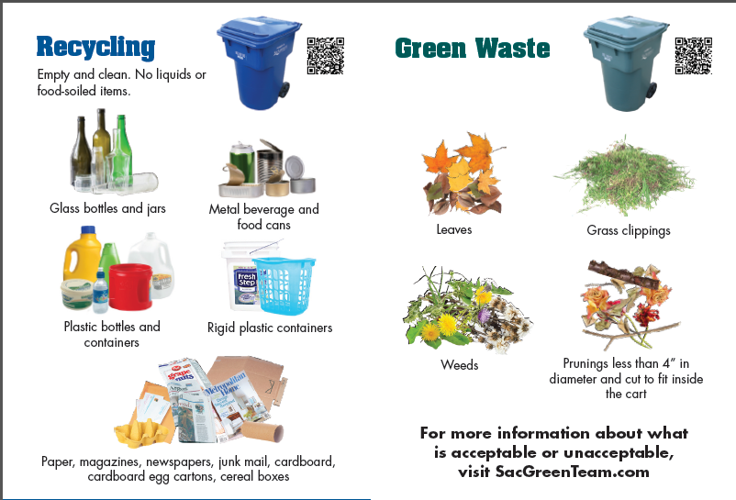
Recycle Right

Slide 7
Single Stream Recyclables Outreach Efforts
Curbside Enhancement Committee – Formed to reduce SSR contamination through customer outreach and education
Revamped service guide and cart tags
Deployed route auditors to inspect and tag carts
Conducted studies to evaluate the effectiveness of traditional outreach, can tagging, and deployment of new carts
Formulated an outreach strategy focusing on reaching customers multiple times through various media

Slide 8
Organics – What is Organic Waste?
Waste Originated from Living Organisms
Green Waste
Wood Waste
Food Waste
Sewage Sludge/Biosolids
Manure
Paper/Cardboard- not required in green cart
Organic Textiles/Carpets- not required in green cart

Slide 9
SB 1383- Short-Lived Climate Pollutants
Primarily targets reducing methane emissions
State wide goals based on 2014 organic waste disposal rates:
2020 –50 percent organic waste reduction from landfills
2025 –75 percent organic waste reduction from landfills
2025 –20 percent increase in recovery of edible food that is currently disposed
Jurisdictions mandated to:
Collect residential and commercial source separated organics on or after 2022
Implement an edible food recovery program on or after 2022

Slide 10
1383 Potential Impacts - Weekly Organic Material Collection
SB 1383 draft regulations require weekly collection of organics.
Currently green waste is collected every other week.
Weekly collection will require a significant expansion of collection fleet.
Discussing the option to collect refuse every other week to reduce costs.

Slide 11
1383 Potential Impacts - Transfer Facilities
Collected organic waste will require different handling procedures than those currently used for green waste.
Currently, DWMR receives and transfers green waste using outdoor facilities.
Adding food waste to collected green waste will require receipt and transferring at indoor facilities.
Significant improvements to the County’s transfer facilities.

Slide 12
1383 Potential Impacts - Increased Organic Diversion Cost
No Solid Waste Facility permitted in Sacramento County to process organic waste containing food waste.
DWMR currently ships approximately 75% green waste for composting to Chico, Ca.
Request for Proposals (RFP) issued for organics diversion services- responses due in May 2019.
Based on regional surveys, we anticipate the cost for transportation and processing will increase significantly.

Slide 13
1383 Potential Impacts - Increased Inspection, Record Keeping and Enforcement
Draft regulations place significant responsibilities on the County:
Robust inspection, record keeping, and enforcement on all generators.
Capacity planning of organics processing infrastructure, conducting quarterly contamination reviews of all organic collection routes, and annual inspection of major food waste generators.
Significant outreach efforts to educate generators.
County will be the designated agency for organics capacity planning County-wide, including incorporated as well as unincorporated areas.

Slide 14
1383 Potential Impacts - Imposed Penalties
SB 1383 draft regulations require jurisdictions to adopt ordinances and impose penalties that are equivalent to or stricter than prescribed penalty amounts.
No threshold or level of contamination given in regulations that constitute a violation.
1st violation -$50-$100 per day
2nd violation - $100-$200 per day
3rd violation -$250-$500 per day
Up to $10,000 per day for jurisdictional violations

Slide 15
What DWMR is Doing in Preparation?
Researching organics collections best practices
Solicited and received Letters of Interest from organics processors
Conducted an greenwaste characterization analysis
Analyzing draft SB 1383 regulatory language
Issued a Request for Proposals for organics diversion services with the Cities of Sacramento and Folsom
Preparing for major routing and fleet maintenance analyses to support decision making
Preparing for a rate increase analysis and request

Slide 16
Conclusions
Chinese policy has significantly impacted the recycling materials market and the price the County pays for SSR processing.
Significant changes in the way organics are collected and processed are on the way.
Organics collection will likely occur weekly, requiring substantial new staff and equipment
Transfer facilities will require significant improvements.
New composting and digester facilities will need to be sited and permitted.
Based on preliminary estimates, DWMR projects rate increases in the range of $10 to $15 per account per month for changes in the SSR and organic recycling programs.

