Slide 1
SACRAMENTO ENVIRONMENTAL COMMISSION
“Sustainable Development & Healthy Communities”
Everyone has a role in this !
Presentation to SACRAMENTO ENVIRONMENTAL COMMISSION
August 20, 2018
Notes:
1
Thanks so much for the invitation to speak to the Environmental Commission, and a chance to talk about some things I’m very passionate about.
The SEC works with City and County agencies and strives to forward its vision of environmental quality, conservation, public health and environmental protection, environmental justice and sustainability throughout Sacramento County.
Learn more about how to help your community
Air Quality, Climate Change Green Landscaping, Agriculture
Energy Conservation Environmental Health, Food Safety
Environmental Justice, Land Use Planning
Solid Waste, Recycling, Hazardous Waste
Transportation Water Fish and Wildlife

Slide 2
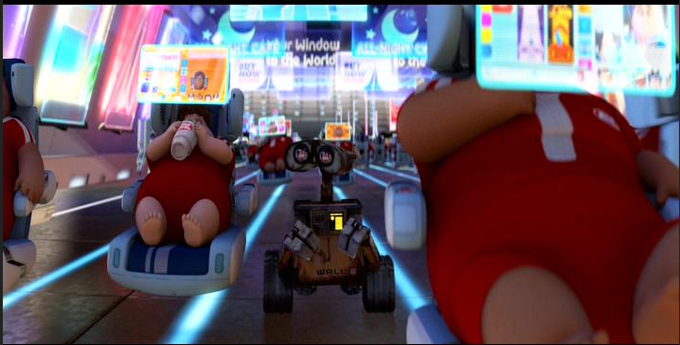
Human Dystopia
The Built Environment Impacts Our Health
Credits: Wall-e Movie, Produced by: Disney
Notes:
The way we plan and develop our communities impacts our health and is changing our climate – BUT you all know this!!
Here’s a photo of Human Dystopia, not Utopia, taken from the Disney movie “Wall-e.” An environment we are rapidly approaching.
We may only be a few years away from riding in autonomous vehicles. Today people are discussing how AV’s will impact our current environment,- What impacts will this have on our health and our climate. These are conversations you need to be involved in.

Slide 3
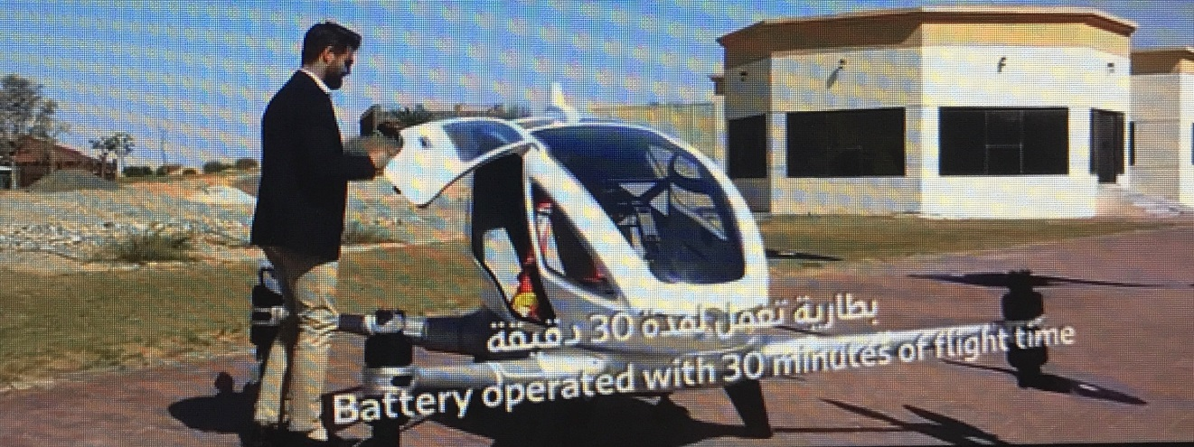
Flying Taxis
Uber plans to conduct test flights of flying taxis in Dallas and Los Angeles in 2020, with commercial service starting as soon as 2023.
Notes:
And because AV’s aren’t enough a new Autonomous Aerial Vehicle (AAV) was scheduled to be in flight in Dubai this July 2017!!
We laugh at Human Dystopia but we really aren’t that far a way from it being a reality!
Each of you are champions and can influence how our communities are built, and reverse impacts on humans and the environment.

Slide 4
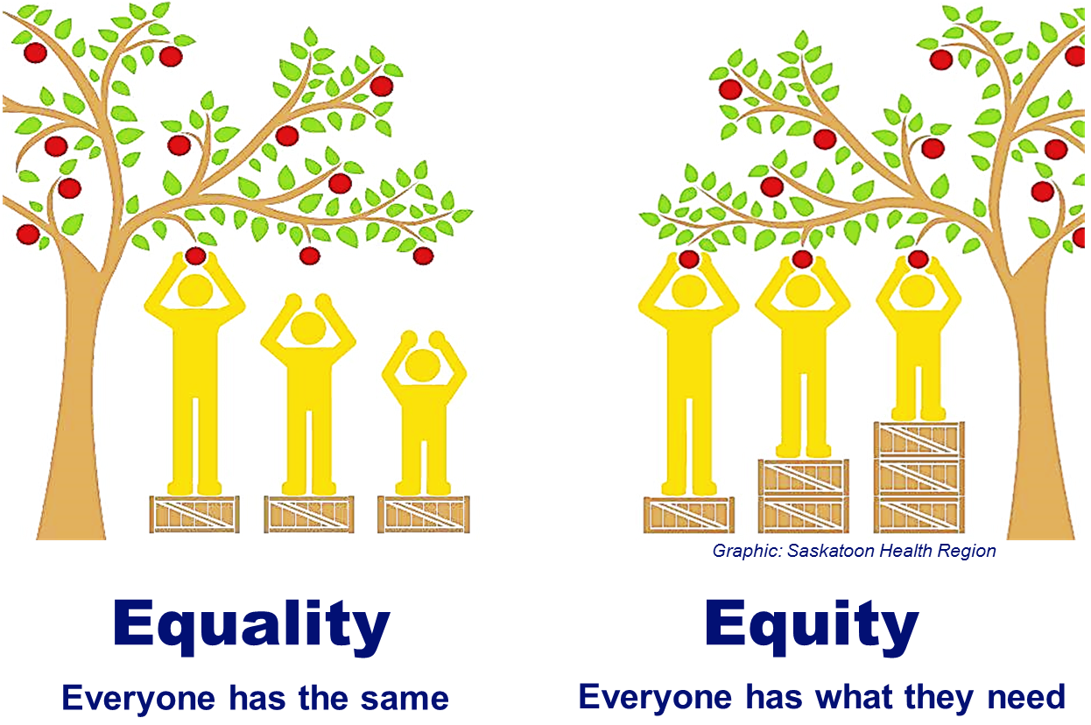
Equity First !
Notes:
Here’s something else you know – EQUITY comes First!! When people have what they need, and it’s different for everyone, then they can thrive and succeed.
Equity needs to be central in all our health and climate work.
______________________________________________________
California law describes “health equity” as “efforts to ensure that all people have full and equal access to opportunities that enable them to lead healthy lives.”

Slide 5
Chronic Disease Prevention
Notes:
So let’s go back to the basics of chronic disease and prevention.
Here’s how people die across our 7 county region:
Heart disease, cancer and respiratory disease.
Our PHO likes to tell us that IN-ACTIVITY IS THE NEW SMOKING.
I’m part of a cross sector health and built environment team that is working to change the way our communities are planned, designed and built to create healthier communities.

Slide 6
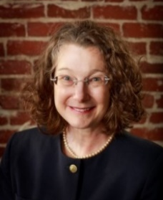
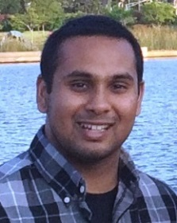
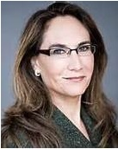
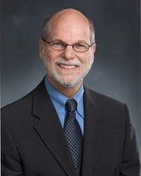
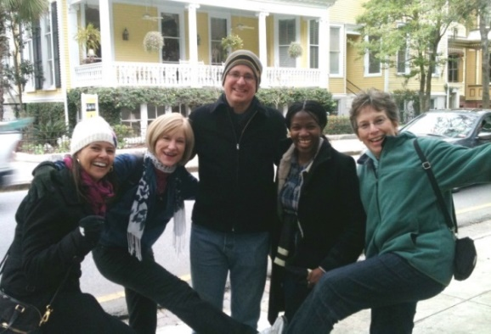
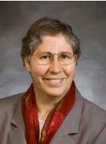
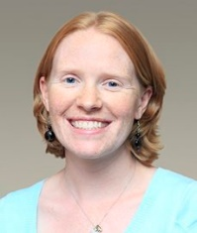
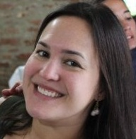
#D4AS
Design 4 Active Sacramento
* Cross sector team of land use and transportation planners, public health and private healthcare physicians.
* Experts on the impacts of the environment on human health.
* Solutions focused team to improve community health.
* Part of a nationwide collaborative of health and built environment experts.
* Provide ongoing trainings, technical assistance and testimony to the health benefits of Active Design.
Notes:
Our Team is called Design 4 Action Sacramento.
Here are my amazing teammates – comprised of Public Health Officers, Private Sector Physicians-including a Neurosurgeon, Transportation Engineer, Air District Health Planner, Land use Planners, Non-profit WALKSacramento and a Univ of Hawaii Professor who teaches Environmental Design and Public Health at the School of Architecture. This is truly a mix of many sectors, identifying intersections of our work with health and how to imbed health in our work.
Let’s talk about health in the built environment and work D4AS has been doing!!! This is highly replicable and necessary to get our communities healthy and resilient to climate effects.

Slide 7
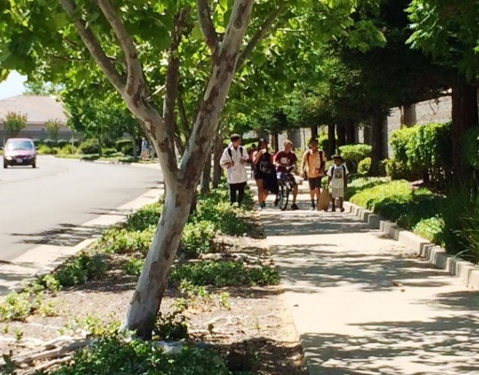
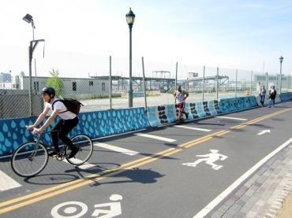
What is Active Design?
Elements within the built environment that encourage more human powered activity.
It’s about HEALTH integrated into transportation, land use, and landscape design.
And, its Sustainable!
Providing public health, economic, environmental, social, and climate resiliency benefits.
Notes:
What’s Active Design?
ACTIVE DESIGN is a combination of infrastructure and behavior design elements that encourage people to move, to be active.
Mixed land uses, active transportation choices, tree canopy (urban greening) and safety all promote and increase physical activity. By incorporating Active Design strategies into the built environment, physical activity and improved health (physical and mental) can be achieved.
It’s the thoughtful and deliberate design of the built environment that influences people’s behavior to WANT to walk, socialize - BE in this place. Plus there are many co- benefits.

Slide 8
Forming Partnerships
The National Leadership Academy for the Public’s Health (NLAPH) provides training to multi-sector teams from across the country to advance their leadership skills and achieve health equity in their community. Funded by CDC, uses an experiential learning process that includes webinars, a multi-day retreat, coaching support, peer networking, and an applied population health project
Notes:
Our team formed to participate in a National Leadership Academy for the Publics Health Program. We met others across the country doing health and built environment work, in particular teams that were part of NYC who were the first to create Active Design Guidelines, and the Center for Active Design.
Being involved with leadership opportunities such as NLAPH also gave our team and project credibility – especially within the county organization.

Slide 9
Policies, Systems and Environmental Change
Notes:
This is a slide I borrowed from Kaiser Permanente – we need Policies – Systems and Environmental Changes to produce healthy outcomes and behaviors. These are all areas we (YOU) can engage in and influence.
That’s what Design 4 Active Sacramento did as our first and biggest project.

Slide 10
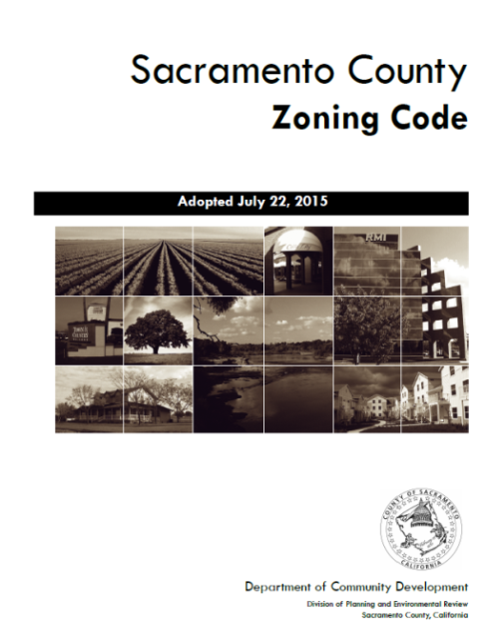
Sacramento County Zoning Code
& Design Guidelines
Chapter 5: DEVELOPMENT STANDARDS
“By incorporating Active Design, identified by this icon , into the built environment, physical activity and improved health can be achieved.”
Notes:
The County decided to update the Zoning Code –not been updated in 30 years. The design guidelines implement the zoning code and were also being updated.
Our team engaged with this County project and provided policies and implementation of active design that advanced health in the built environment. Wrote new guidelines, created a walking person icon that identifies health supportive guidelines, an appendix document that laid the foundation for what active design is, how it helps reduce chronic disease, and what active design looks like.
While doing this work we engaged others who were at the forefront of doing community health work: the Air District, Health Centers, Non-profits so that our worked also helped them. They in turn wrote a lot of letters of support to the Board of Supervisors!
These were adopted by the Board of Supervisors July 2015
Also- never underestimate the power of your local Public Health Officer!!

Slide 11
General Plan, Codes, Design…
addresses climate change and HEALTH !
Notes:
Sac County and D4AS initiated all of these through updating it’s General Plan Housing Element, Zoning Code and Design Guidelines with an eye on Health.
What’s really helped this work in California is Health in All Policies, the July 2017 new General Plan Guidelines that has a voluntary “healthy communities element” which includes climate change.
The biggest influencer is SB1000-a new mandatory Environmental Justice Element that among other things REQUIRES that health be addressed for all cities and counties that have disadvantaged communities. This update must happen “upon the adoption or next revision of two or more elements on or after January 1, 2018.”
The intent is to create healthier communities by protecting sensitive land uses and prioritizing the needs of disadvantaged communities.

Slide 12
- May 26, 2016 SACOG
2nd Regional Convening
June 7, 2017
Notes:
In 2016 D4AS was part of the national Plan4Health program in partnership with the APA and APHA. Getting Planning and Health to work together.
In 2016 and again in 2017 we brought together Planning Directors Public Health Officers, and Friends of Health from across the 7 county region and shared ways they can work together.
Many had never met before, and they weren’t working together.
These are relationships, partnerships and collaboration we are part of, which continues to grow. Partnerships are everywhere - even the San Francisco Federal Reserve Bank!

Slide 13
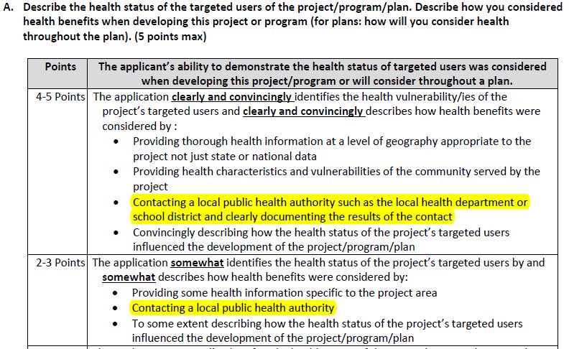
2017 CalTrans - Active Transportation Program Scoring Rubrics
QUESTION #5: IMPROVED PUBLIC HEALTH (0-10 POINTS)
Notes:
We worked with Ca Dept of Public Health, CalTrans and statewide Public Health Officers to get language added to the CalTrans ATP Scoring rubrics that rewards applicants to work with their Public Health authority. THIS IS HUGE!!
2 points can make the difference in being funded, OR NOT!

Slide 14
What’s Good for Health… is Good for Climate
Notes:
What’s good for health is good for climate
What is Sacramento and others doing to prepare our communities for a changing climate that also bring health benefits with them?

Slide 15
Climate & Health Hazards-Flooding
Downtown Sacramento-Winter 2017
Notes:
One of my favorites of Downtown Sacramento and Discovery Park this past winter.

Slide 16
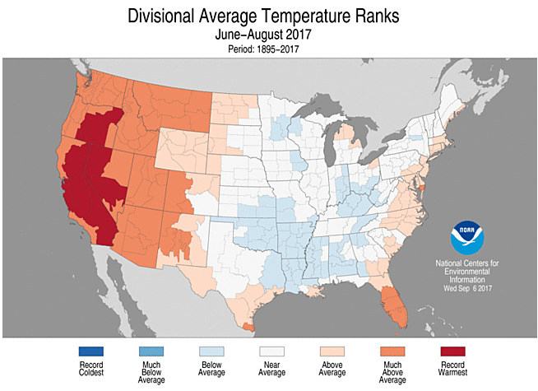
Climate & Health Hazards-Heat
2017 California Hottest Summer on-record !
Notes:
Sacramento and other parts of California have significant heat issues compounded by urban heat islands and extreme heat events.
2017 was the hottest summer on record!!

Slide 17
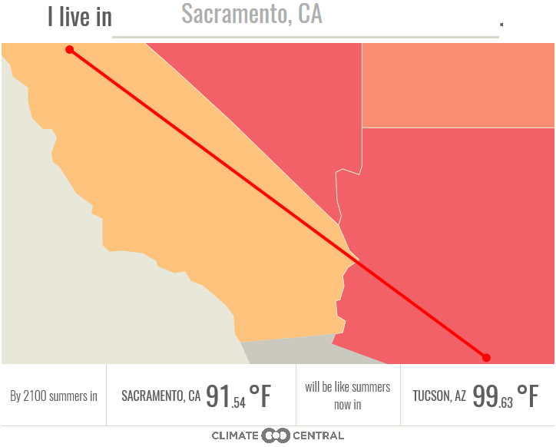
By 2100 Sacramento summers will be like summers NOW in TUCSON, AZ
Notes:
Here are some climate facts

Slide 18
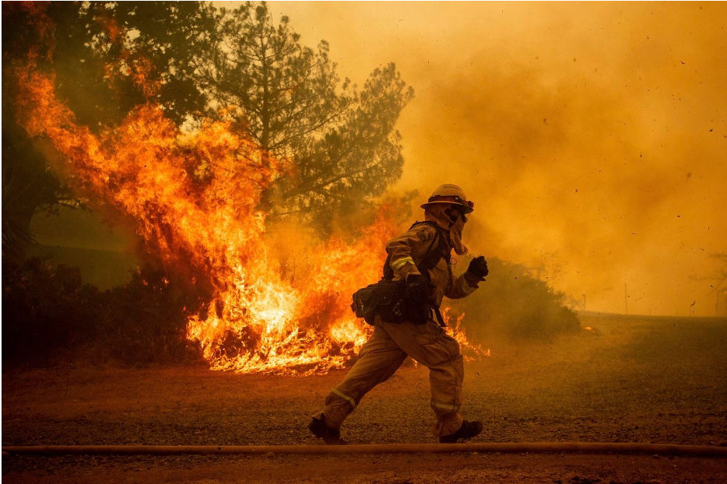
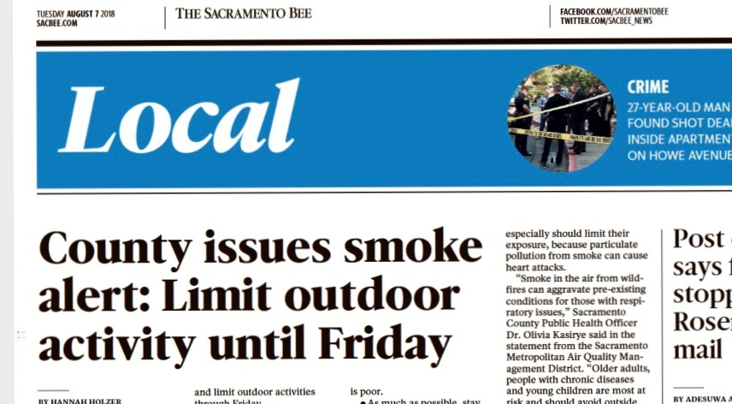
Climate & Health Hazards-Wildfires
2017 California’s Wildfire Season - Worst on Record,
2018 on track to set new record!!
Notes:
California’s 2017 wildfire season was the worst on record according to CalFire. More than ½ million acres have burned so far this year and the unseasonably warm weather in So Cal is extending the fire season there.
This information was reported Nov 24, 2017.
So how do we become more resilient to our changing climate and integrate health??

Slide 19
Health Benefits of Sustainable Practices
Notes:
This slide was created by the Urban Land Institute in a Sustainable Stormwater Practices document they created. The benefits aren’t only flood related – there are environmental, physical and mental health benefits. You can help Civil Engineers and others connect the dots on projects and health benefits while still meeting the needs and purposes of their projects.
Those of you with Public Health degrees add amazing benefit to these other sectors-so please consider working outside of the typical public health setting.
Policies don't mean anything unless they're implemented!!! Let's see how we do that....

Slide 20
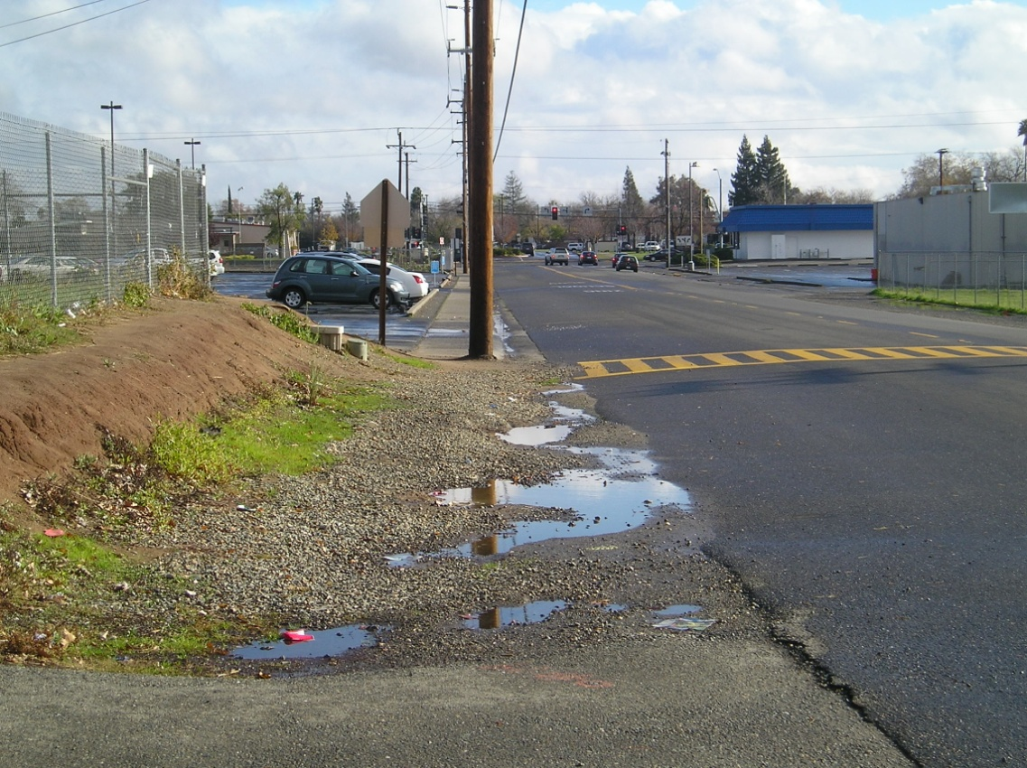
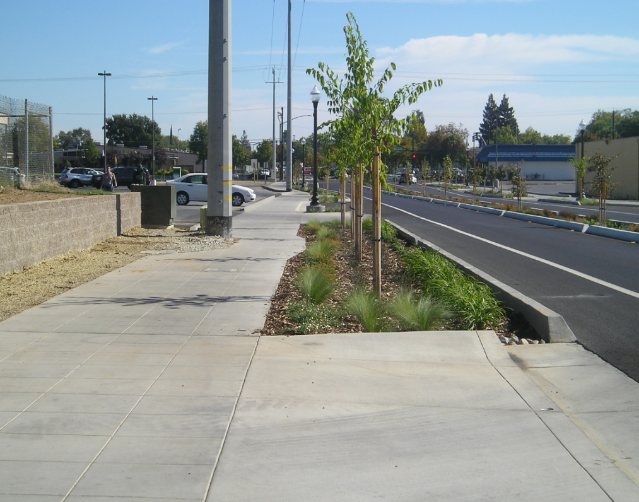
What it looks like “in the ground”
Freedom Park Drive Green, Complete Street
before & after
Notes:
This is what it looks like in the ground.
Freedom Park Drive Green Street actually was a VERY SUCCESSFUL pilot project. Does everyone know what a green street is?
Complete streets are safer for pedestrians and bicyclists and accommodate ALL transportation modes, not just the auto. This design will help reduce pedestrian accidents and injuries. With sidewalks separated from the street more people feel safer walking so they will choose to walk and not drive
It’s an example of imbedding health, physical activity (also called active design) and climate resiliency into infrastructure projects..
This street is also in a disadvantaged community.
It’s also an example of equity. Before “No sidewalks,” After- lighting and sidewalks, just like everybody else.

Slide 21
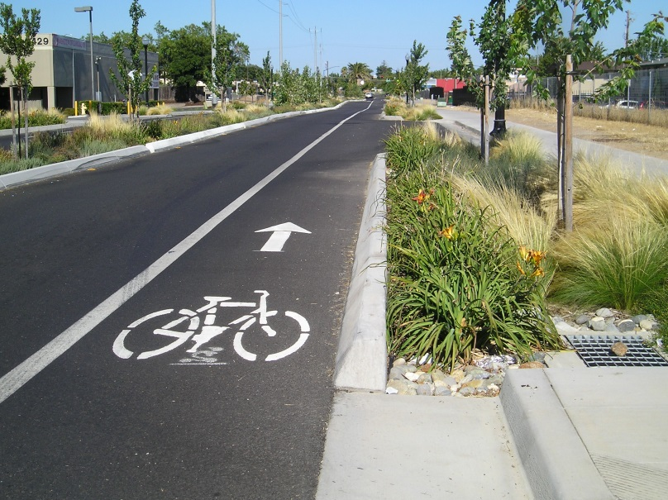
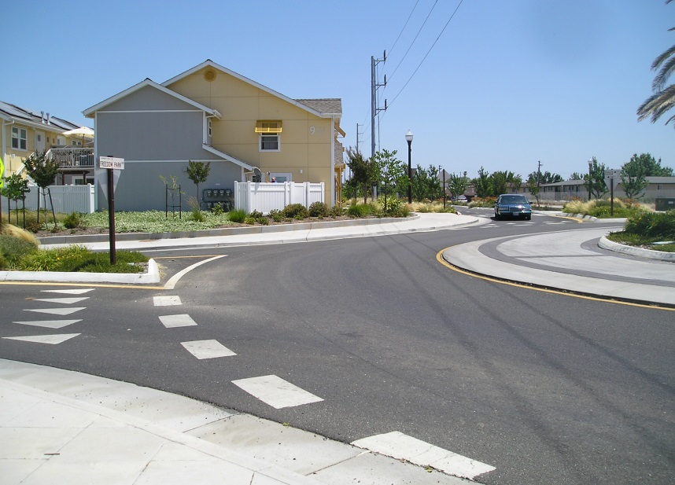
Notes:
Here are performance metrics - for this street
Beyond low impact development- many GHG reducing benefits

Slide 22
Notes:
Now the health benefits….
Being a “street” was the least of what this street actually provided and achieved

Slide 23
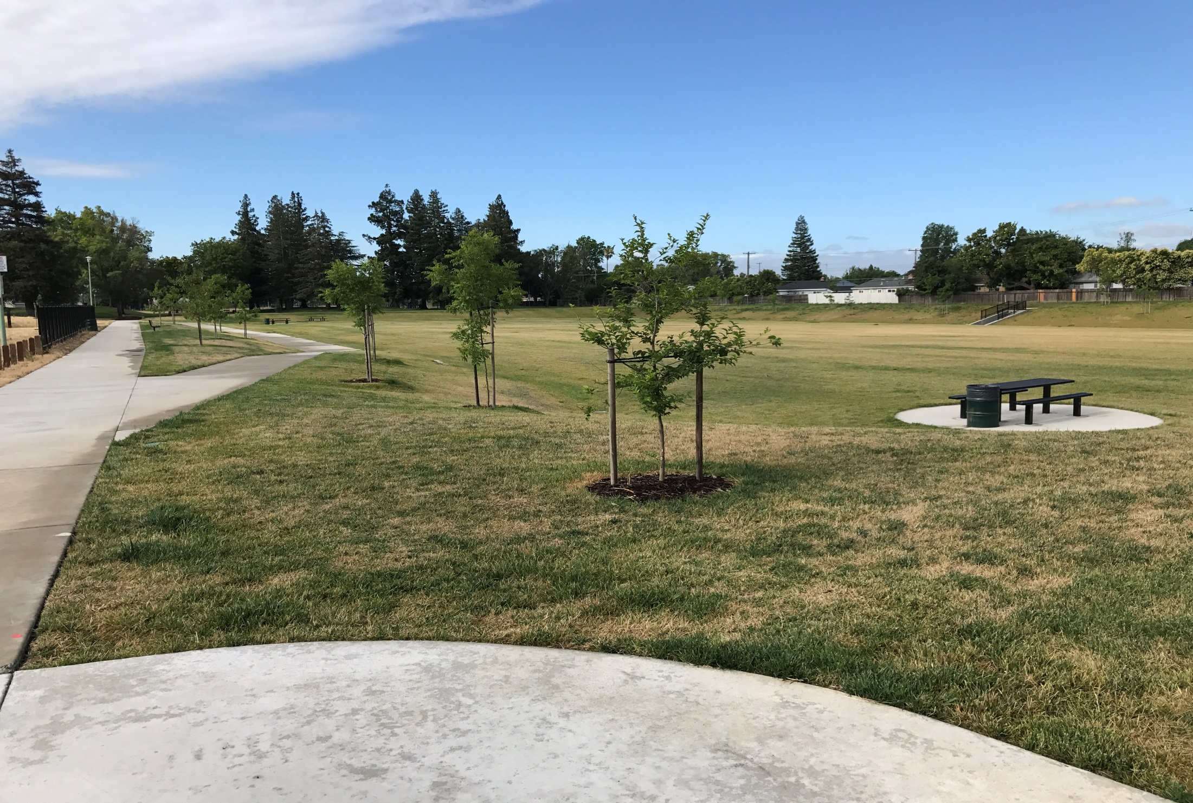
Florin Creek Joint Use Park & Flood Detention Basin
Notes:
Here’s a recently completed joint use park and flood detention basin in South Sacramento, developed in collaboration with SAFCA and Southgate Park District.
This is a flood and drainage facility-and is also a community amenity. We all know the benefits parks bring to community health!
This should be a standard requirement for projects. Not a new idea.

Slide 24
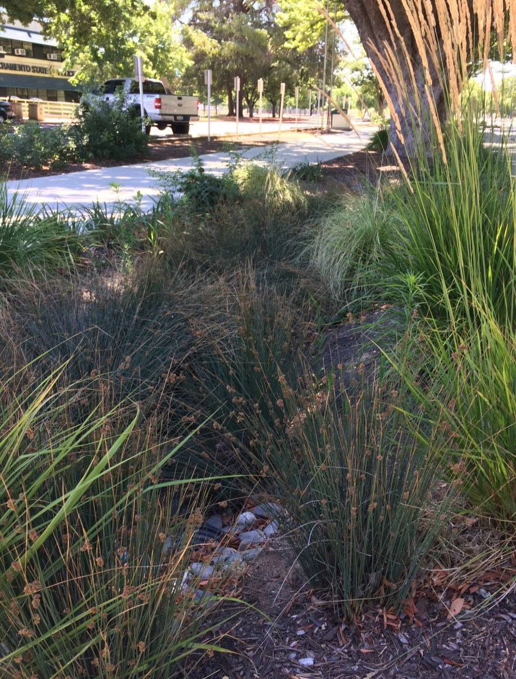
CSU,Sac Green Infrastructure
Notes:
Here’s an area at Sac State where they’ve used permeable pavement in parking areas of the street (Jedediah Smith Dr) and LID in the adjacent landscape areas to catch water from the surrounding areas.
These are all sustainable green infrastructure projects, that have multiple co-benefits than just drainage. These projects contribute greatly to urban heat island reduction, improved air and water quality, water conservation, and reducing GHG emissions. These add aesthetics to its surroundings, and promote physical and mental health.
These are examples of projects that help reduce GHG emissions, improve health AND help to reduce the impacts from our changing climate using more natural systems.

Slide 25
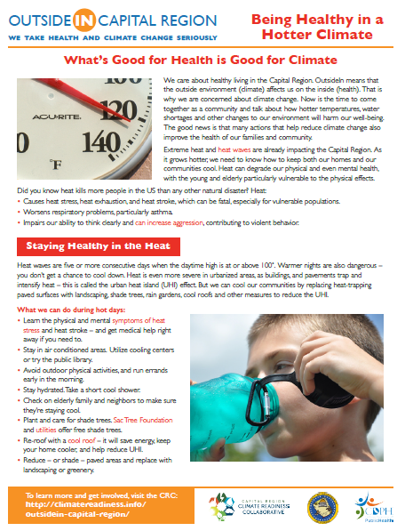
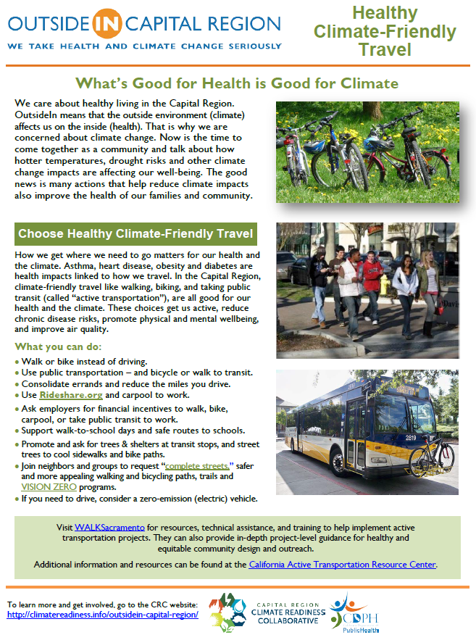
Climate & Health Fact Sheets
A regional forum tackling resilience. Really need health involved!! Through collaboration, the Sacramento Region
can adapt to known
and predicted impacts;
creating stronger,
healthier, sustainable,
& more economically viable communities.
Notes:
Climate & Health Fact Sheets-CDPH and CRC
Kathleen will discuss the CRC- Capital Region Climate Readiness Collaborative and the statewide ARCCA - The Alliance of Regional Collaboratives for Climate Adaptation (ARCCA) during her presentation.
These regional collaboratives from across California are already coordinating and supporting climate adaptation efforts in order to enhance public health, protect natural systems, build economies, and improve quality of life.
These Climate and Health fact Sheets are intended for use by the general public, to inform them of the connections between health and climate. They were originally done by San Luis Obispo Dept of Public Health. CRC has been working with CDPH to develop fact sheets specifically for our regions climate hazards and will be posted on the CRC website for use.
GET INVOLVED!!! Educate, advocate and legislate.
is about EVERYTHING we do!”

Slide 26
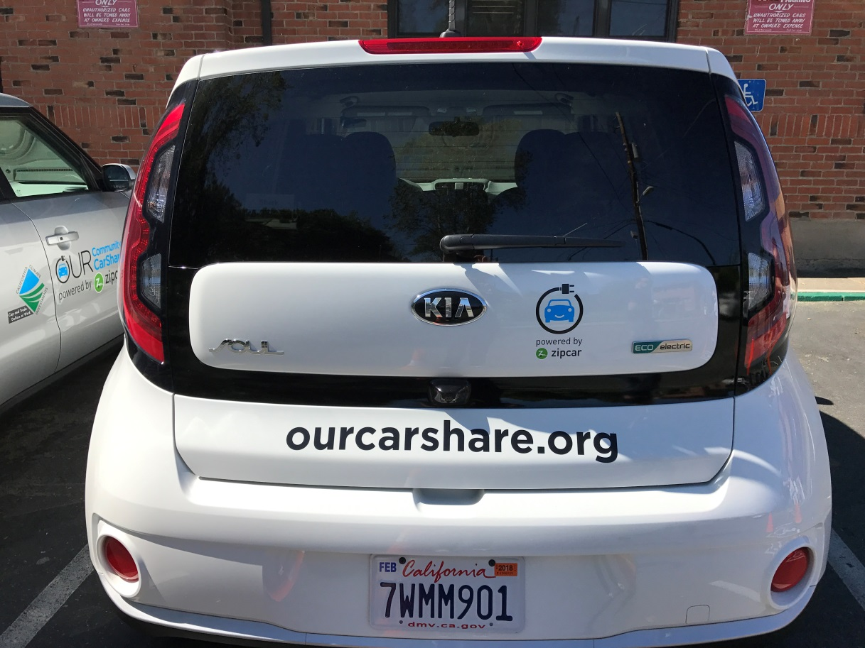
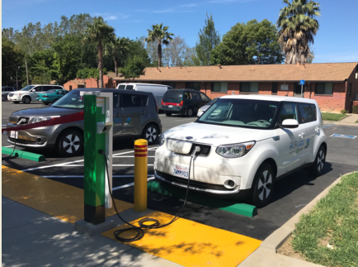
Electric Car Share-DAC’s
“Our Community CarShare Sacramento” Provides EVs to Affordable Housing Community
Notes:
Another step toward health equity is helping address transportation issues in disadvantaged communities. This past May, Sacramento launched it’s first electric car share program. The residents of 4 different affordable housing complexes can use the cars for trips to the grocery store, doctors’ appointments, job interviews and other errands.
__________________________________________________
In addition to the clean air benefits, Sac County PHO Dr. Kasirye testified before the ARB on the related health benefits such an EV car share brings…including redirecting money from having to buy gas to now being able to buy food!

Slide 27
Notes:
Thank you for the opportunity to talk with you today about the CRC and some of the work that we’re doing. I hope by the time we’re done here today, many of you will consider participating. Some of your agencies may already be members!

Slide 28
Members
The Capital Region Climate Readiness Collaborative is a program of the Local Government Commission.
Channel Partners
Notes:
Here are many of our current members. Placer County is currently in the process of joining.

Slide 29
What the CRC Collaborative does
Build connections: Stay connected to cities and counties actively working to address climate impacts
Regional climate network: Reach out more effectively to a regional network
Smart partnerships: Work with local jurisdictions on programs and projects of shared interest.
Adaptation leadership: Help influence and support future projects and direction for regional climate adaptation.
Opportunities for Education & Collaboration: Vibrant statewide network of professionals working on climate resiliency in their regions.
www.climatereadiness.info
Notes:
What do we do?
Share information on how our climate is changing, replicable adaptation measures and projects, education and training, share new research and pilots underway. Connect members to climate experts or others working on similar projects to leverage and grow resources for successful outcomes.
Technical Assistance: CRC climate experts participated in the County’s LHMP process, added valuable information and resources to the final document.
Several initiatives underway: one is urban heat island effects and another on urban-rural interface that I’ll discuss more in this presentation.
Both of these initiatives can be significantly influenced by the work flood plain managers do and how flood projects are designed and built. So lets start with heat.

Slide 30
All About Collaboration
Think Differently
Don’t think outside the box,
THINK LIKE
THERE IS
NO BOX
Notes:
We need to think differently. Don’t think outside the box,
Think like there is NO BOX!!

Slide 31
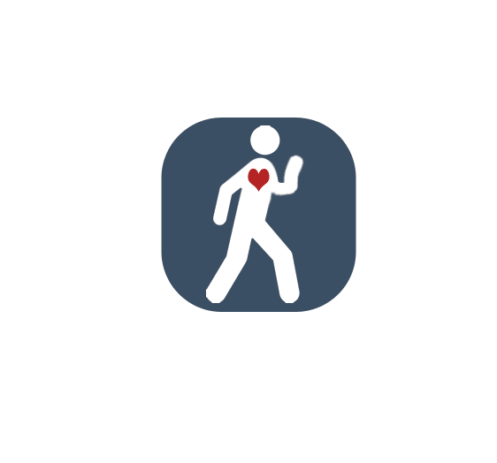
Thank You !!
Judy Robinson
Sustainability Manager
Team Lead, Design 4 Active Sacramento
Executive Committee Member, CRC
Robinsonju@saccounty.net
916-874-4551
Notes:
Thank you for being part of a healthier and more equitable future!

